Slide 1




ARTIFICIAL INTELLIGENCE
Dayananda Sagar University (DSU)- Main Campus
School of Engineering
Devarakaggalahalli, Harohalli Kanakapura Road, Ramanagara, Karnataka 562112
Department of Computer Science & Engineering
(Artificial Intelligence & Machine Learning)
SEMESTER – IV
Course Code: 23AM2405
23AM2405

Slide 2
SOE Vision-Mission
23AM2405
VISION
To be a centre of excellence in education, research & training, innovation & entrepreneurship and to produce citizens with exceptional leadership qualities to serve national and global needs.
MISSION
To achieve our objectives in an environment that enhances creativity, innovation and scholarly pursuits while adhering to our vision.

Slide 3
AIML Vision-Mission
23AM2405
Vision
Develop highly competent engineers in the field of AI & ML contributing globally to the benefit of industry and society.
Mission
To develop state-of-the-art academic and infrastructural facilities with the latest tools and other learning resources supported by curriculum that can produce self-sustainable professionals.
To emerge as a research centre that interacts with industry on a regular basis for imparting wholistic curriculum to the students.
To impart emerging skill sets that the industry require, apart from ensuring that the soft skills of the learners are given adequate thrust.

Slide 4
Course Learning Objectives
23AM2405
This course will enable students to:
To provide a strong foundation of fundamental concepts in artificial intelligence.
To provide a basic exposition of different types of searching in Artificial intelligence.
To provide different knowledge representation, reasoning, and learning techniques.
To distinguish the different types of expert systems.
To design the Expert System based on the concepts of knowledge representation, searching and Reasoning on various applications using modernised AI tools.

Slide 5
Course Outcome
23AM2405
CO No. | Outcomes | Bloom’s Taxonomy Level
CO1 | Summarize the basic concepts of Artificial Intelligence, AI principles, AI Task domains and applications. | L2
CO2 | Apply the different types of searching and knowledge representations techniques to solve the AI problems. | L3
CO3 | Make use of the different types of reasoning such as Monotonic Reasoning, Non-Monotonic Reasoning and Statistical Reasoning techniques for making analysis and predictions. | L3
CO4 | Differentiate the various types of Experts Systems such as Rule Based, Model Based, Case Based, Hybrid and Fuzzy Expert Systems. | L2
CO5 | Design the Expert System based on the concepts of knowledge representation, searching and Reasoning on various applications using modernised AI tools. | L6

Slide 6
Text Documents Requirement
23AM2405
Textbooks:
Artificial Intelligence, George F Luger, Sixth Edition, Pearson Education Publications, 2014.
Artificial Intelligence, Elaine Rich and Knight, McGraw-Hill Publications, 2010.
Reference Books:
Artificial Intelligence: A modern Approach, Russell and Norvig, Printice Hall, 2010.
Introduction To Artificial Intelligence & Expert Systems, Patterson, PHI.
Multi Agent systems- a modern approach to Distributed Artificial intelligence, Weiss. G, MIT Press.
Artificial Intelligence: A modern Approach, Russell and Norvig, Printice Hall.

Slide 7
Teaching-Learning Process (General Instructions)
23AM2405
These are sample new pedagogical methods that teachers can use to accelerate the attainment of the various course outcomes.
Lecture method means it includes not only the traditional lecture method but a different type of teaching method that may be adopted to develop the course outcomes.
Interactive Teaching: Adopt Active learning that includes brainstorming, discussing, group work, focused listening, formulating questions, note-taking, annotating, and roleplaying.
Show Video/animation films to explain the functioning of various concepts.
Encourage Collaborative (Group Learning) Learning in the class.
To make Critical thinking, ask at least three Higher-order Thinking questions in the class.
Discuss how every concept can be applied to the real world - and when that's possible, it helps improve the student's understanding.

Slide 8
Content of Syllabus
23AM2405
Unit-1 : Introduction | Contact Hours
Introduction: Artificial Intelligence, AI Problems, AI Techniques: supervised learning, unsupervised learning, and reinforcement learning, Different Types of Agents: Simple reflex agents, Model‐based reflex agents, Goal‐based agents and Utility‐based agents; Environment, Problem Space and Search, Defining the Problem as a State Space Search, Problem Characteristics. Textbook 2: Chapter 1,2 | 08
Unit – 2 : Basic Search Techniques
Basic Search Techniques: Solving problems by searching; issues in the design of search programs; uniform search strategies: Breadth first search, Depth first search, Depth limited search, Bidirectional search, Best First search. Textbook 3: Chapter 3, 4; Textbook 2: Chapter 2, 3 | 08

Slide 9
23AM2405
Unit-3 : Special Search Techniques & Knowledge Representation | Contact Hours
Special Search Techniques: Heuristic Search, greedy best first search, A* search, AO*Algorithm, Hill climbing search, Simulated Annealing search, Adversarial search, Minimax search, Alpha, beta pruning, Genetic Algorithm. Knowledge Representation: Procedural Vs Declarative Knowledge, Approaches to Knowledge Representation, Forward Vs Backward Reasoning. Textbook 1: Chapter 5; Textbook 2: Chapter 3, 6 | 08
Unit – 4 : Symbolic Logic, Reasoning & Statistical Reasoning
Symbolic Logic: Propositional Logic, First Order Predicate Logic: Representing Instance and isa Relationships. Reasoning: Introduction to Monotonic Reasoning and Non-Monotonic Reasoning. Statistical Reasoning: Bayes Theorem, Certainty Factors, Bayesian Networks, Dempster-Shafer Theory. Textbook 2: Chapter 7,8 | 07

Slide 10
23AM2405
Unit-5 : Experts Systems | Contact Hours
Experts Systems: Overview of an Expert System, Structure of an Expert Systems, Different Types of Expert Systems: Rule Based, Model Based, Case Based and Hybrid Expert Systems, Knowledge Building System Tools, Expert System Shells and Fuzzy Expert systems. Textbook 1: Chapter 8,9; Textbook 2: Chapter 20,22 | 08
Unit | CO-Mapping
Unit1 | CO1
Unit2 | CO2
Unit3 | CO2
Unit4 | CO3
Unit5 | CO4 & CO5

Slide 11
PEO'S
23AM2405
PEO1. Promote design, research, product implementation and services in the field of Artificial Intelligence Engineering through strong technical, communication and entrepreneurial skills
PEO2. Engage to work productively as design and development Engineers, cater to supportive and leadership roles in multidisciplinary domains.
PEO3. Learn and advance their careers by attaining professional certification and seeking higher education.
PEO4. Possess skill in AI & ML expertise ready to serve the society locally and internationally

Slide 12
PO'S
23AM2405
PO1. Engineering knowledge
PO2. Problem analysis
PO3. Design/development of solutions
PO4. Conduct investigations of complex problems
PO5. Modern tool usage
PO6. The engineer and society
PO7. Environment and sustainability
PO8. Ethics
PO9. Individual and team work
PO10. Communication
PO11. Project management and finance
PO12. Life-long learning

Slide 13
PSO'S
23AM2405
PSO1. Apply the principal concepts of AI Engineering to design, develop, deploy and prototype AI Subsystems
PSO2. Apply the knowledge gained pertaining to data storage, data analytics and AI concepts to solve real world business problems.
PSO3. Apply, analyse, design, develop, and test principles of AI concepts on Intelligent Systems

Slide 14
(Old PSO’S)
23AM2405
Table: Mapping Levels of COs to POs / PSOs
COs | Program Outcomes (POs) |  |  |  |  |  |  |  |  |  |  |  | PSOs
 | Engineering knowledge | Problem analysis | Design/development of solutions | Conduct investigations of complex problems | Modern tool usage | The engineer and society | Environment and sustainability | Ethics | Individual and team work | Communication | Project management and finance | Life-long learning | Apply the principal concepts of AI Engineering to design, develop, deploy and prototype AI Subsystems | Apply the knowledge gained pertaining to data storage, data analytics and AI concepts to solve real world business problems. | Apply, analyse, design, develop, and test principles of AI concepts on Intelligent Systems
CO1 | 2 | - | - | - | 2 | 1 | - | - | 1 | 1 | - | - | 2 | 2 | 2
CO2 | 3 | 2 | - | - | 2 | 1 | - | - | 1 | 1 | - | - | 2 | 2 | 2
CO3 | 3 | 2 | - | - | 2 | 1 | - | - | 1 | 1 | - | - | 2 | 2 | 2
CO4 | 3 | 2 | - | - | 2 | 1 | - | - | 1 | 1 | - | - | 2 | 2 | 2
CO5 | 3 | 3 | 2 | - | 2 | 1 | - | - | 1 | 1 | - | - | 2 | 2 | 2
3: Substantial (High) 2: Moderate (Medium) 1: Poor (Low)

Slide 15
(New PSO’S)
Table: Mapping Levels of COs to POs / PSOs
COs | Program Outcomes (POs) |  |  |  |  |  |  |  |  |  |  |  | PSOs
 | Engineering knowledge | Problem analysis | Design/development of solutions | Conduct investigations of complex problems | Modern tool usage | The engineer and society | Environment and sustainability | Ethics | Individual and team work | Communication | Project management and finance | Life-long learning | Apply Analytical, Mathematical and Programming Skills in AI and ML domain for Design and Development, Analyse and test principles of Intelligent Systems used to solve Real World Problems. | Formulate & Build Optimized Solutions for Computationally Intensive Applications. | PO’s Average
CO1 | 2 | - | - | - | 2 | 1 | - | - | 1 | 1 | - | - | 2 | 2 | 1.40
CO2 | 3 | 2 | - | - | 2 | 1 | - | - | 1 | 1 | - | - | 2 | 2 | 1.66
CO3 | 3 | 2 | - | - | 2 | 1 | - | - | 1 | 1 | - | - | 2 | 2 | 1.66
CO4 | 3 | 2 | - | - | 2 | 1 | - | - | 1 | 1 | - | - | 2 | 2 | 1.66
CO5 | 3 | 3 | 2 | - | 2 | 1 | - | - | 1 | 1 | - | - | 2 | 2 | 1.85
23AM2405
3: Substantial (High) 2: Moderate (Medium) 1: Poor (Low)

Slide 16
23AM2405
E-Resources:
https://onlinecourses.nptel.ac.in/noc22_cs56/preview
https://onlinecourses.nptel.ac.in/noc23_ge40/preview
Activity Based Learning (Suggested Activities in Class)
Flipped Class Activity on Searching Techniques.
Problem Solving and Discussion.
Mini Project (presentation & Report)

Slide 17
Marks division
23AM2405
100 Marks
60 (CIA)
40 (SEE)

Slide 18
CIA Marks Split Up – 60M
23AM2405
Internal Assessment – 40M (Average of 2 MSE).
MSE (Mid Semester Examination) Will be conducted twice in a semester.
Total marks for MSE Question Paper will be 40M.
Average of 2 MSE will be considered for awarding the MSE total marks out of 40M
MSE-1 Portions will be from Unit 1 & 2
MSE-2 portions will be from Unit 3 & 4
Other Components – 20M
Mini Project (Report 15-20 pages minimum, Upload PPT and Video link). – 15M (4 Members for Batch Mandatory)
Open test/Quiz – 5M
Below 75% -0M (chances of getting detained)

Slide 19
SEE Marks Split Up – 40M
23AM2405
SEE (Semester End Examination), Will be conducted at the end of the 3rd semester.
Total marks for SEE Question Paper will be 100M.
Later 100M will be scaled down to 40M
SEE Question paper will consist of 5Questions (each module will have one full question, and Each question carries a maximum of 20 Marks)

Slide 20
Prerequisites – Brush up course
23AM2405
Introduction to C Program
Introduction to Python
Keywords in C & python
Basic difference between C & python Programming
Sample examples program in Python.

Slide 21
Sample Programs
23AM2405
# This program prints Hello, world!
print('Hello, world!')
# This program adds two numbers
num1 = 1.5
num2 = 6.3
# Add two numbers
sum = num1 + num2
# Display the sum
print('The sum of {0} and {1} is {2}'.format(num1, num2, sum))
sum = 5+2
print ('the sum is{0}'.format(sum))
# Store input numbers
num1 = input('Enter first number: ')
num2 = input('Enter second number: ')
# Add two numbers
sum = float(num1) + float(num2)
diff = float(num1)-float(num2)
# Display the sum
print('The sum of {0} and {1} is {2}'.format(num1, num2, sum))
print('the difference of {0} and {1} is {2}'.format(num1,num2,diff))

Slide 22
Importing Function
# Program to generate a random number between 0 and 9
# importing the random module
import random
print(random.randint(0,9))
23AM2405
# Program to display calendar of the given month and year
# importing calendar module
import calendar
# To take month and year input from the user
year = int (input("Enter year: "))
month= int(input("Enter month: "))
#yy = int(input("Enter year: "))
#mm = int(input("Enter month: "))
# display the calendar
print(calendar.month(year, month))

Slide 23
# Display the powers of 2 using anonymous function
terms = 10
# Uncomment code below to take input from the user
# terms = int(input("How many terms? "))
# use anonymous function
result = list(map(lambda x: 2 ** x, range(terms)))
print("The total terms are:",terms)
for i in range(terms):
print("2 raised to power",i,"is",result[i])
23AM2405
number = int(input ("Enter the number of which the user wants to print the multiplication table: "))
# We are using "for loop" to iterate the multiplication 10 times
print ("The Multiplication Table of: ", number)
for count in range(1, 11):
print (number, 'x', count, '=', number * count)

Slide 24
# Program to multiply two matrices using nested loops
# 3x3 matrix
X = [[12,7,3],
[4 ,5,6],
[7 ,8,9]]
# 3x4 matrix
Y = [[5,8,1,2],
[6,7,3,0],
[4,5,9,1]]
# result is 3x4
result = [[0,0,0,0],
[0,0,0,0],
[0,0,0,0]]
23AM2405
# iterate through rows of X
for i in range(len(X)):
# iterate through columns of Y
for j in range(len(Y[0])):
# iterate through rows of Y
for k in range(len(Y)):
result[i][j] += X[i][k] * Y[k][j]
for r in result:
print(r)

Slide 25
Unit 1: Introduction
23AM2405
Unit-1 : Introduction | Contact Hours
Introduction: Artificial Intelligence, AI Problems, AI Techniques: supervised learning, unsupervised learning, and reinforcement learning, Different Types of Agents: Simple reflex agents, Model‐based reflex agents, Goal‐based agents and Utility‐based agents; Environment, Problem Space and Search, Defining the Problem as a State Space Search, Problem Characteristics. Textbook 2: Chapter 1,2 | 08

Slide 26
Artificial Intelligence
23AM2405
Intelligence: “ability to learn, understand and think” (Oxford dictionary)
AI is the study of how to make computers make things which at the moment people do better.
Examples: Speech recognition, Smell, Face, Object, Intuition, Inference, Learning new skills, Decision making, Abstract thinking.

Slide 27
What AI Can DO
23AM2405
Thinking humanly | Thinking rationally
Acting humanly | Acting rationally

Slide 28
Acting humanly
23AM2405
The first proposal for success in building a program and acts humanly was the Turing Test. To be considered intelligent a program must be able to act sufficiently like a human to fool an interrogator. A human interrogates the program and another human via a terminal simultaneously. If after a reasonable period, the interrogator cannot tell which is which, the program passes.
To pass this test requires:
Natural language processing
Knowledge representation
Automated reasoning
Machine learning
This test avoids physical contact and concentrates on "higher level" mental faculties. A total Turing test would require the program to also do:
Computer vision
Robotics

Slide 29
Thinking Humanly
23AM2405
This requires "getting inside" of the human mind to see how it works and then comparing our computer programs to this. This is what cognitive science attempts to do. Another way to do this is to observe a human problem solving and argue that one's programs go about problem solving in a similar way.
Example: GPS (General Problem Solver) was an early computer program that attempted to model human thinking. The developers were not so much interested in whether or not GPS solved problems correctly. They were more interested in showing that it solved problems like people, going through the same steps and taking around the same amount of time to perform those steps.

Slide 30
Thinking Rationally
23AM2405
Aristotle was one of the first to attempt to codify "thinking". His syllogisms provided patterns of argument structure that always gave correct conclusions, giving correct premises. Example: All computers use energy. Using energy always generates heat. Therefore, all computers generate heat.
This initiate the field of logic. Formal logic was developed in the late nineteenth century. This was the first step toward enabling computer programs to reason logically.
By 1965, programs existed that could, given enough time and memory, take a description of the problem in logical notation and find the solution, if one existed. The logicist tradition in AI hopes to build on such programs to create intelligence.
There are two main obstacles to this approach: First, it is difficult to make informal knowledge precise enough to use the logicist approach particularly when there is uncertainty in the knowledge. Second, there is a big difference between being able to solve a problem in principle and doing so in practice.

Slide 31
Acting Rationally: The rational agent approach
23AM2405
Acting rationally means acting so as to achieve one's goals, given one's beliefs. An agent is just something that perceives and acts.
In the logical approach to AI, the emphasis is on correct inferences. This is often part of being a rational agent because one way to act rationally is to reason logically and then act on ones conclusions. But this is not all of rationality because agents often find themselves in situations where there is no provably correct thing to do, yet they must do something.
There are also ways to act rationally that do not seem to involve inference, e.g., reflex actions.
The study of AI as rational agent design has two advantages:
It is more general than the logical approach because correct inference is only a useful mechanism for achieving rationality, not a necessary one.
It is more amenable to scientific development than approaches based on human behaviour or human thought because a standard of rationality can be defined independent of humans.
Achieving perfect rationality in complex environments is not possible because the computational demands are too high. However, we will study perfect rationality as a starting place.

Slide 32
AI Definition
23AM2405
The automation of activities that we associate with human thinking (e.g., decision-making, learning…)
The art of creating machines that perform functions that require intelligence when performed by people.
The study of mental faculties through the use of computational models.
A field of study that seeks to explain and emulate intelligent behavior in terms of computational processes.
The branch of computer science that is concerned with the automation of intelligent behavior.
AI is part science, part engineering
AI often must study other domains in order to implement systems
AI is a belief that the brain is a form of biological computer and that the mind is computational
AI has had a concrete impact on society but unlike other areas of CS, the impact is often

Slide 33
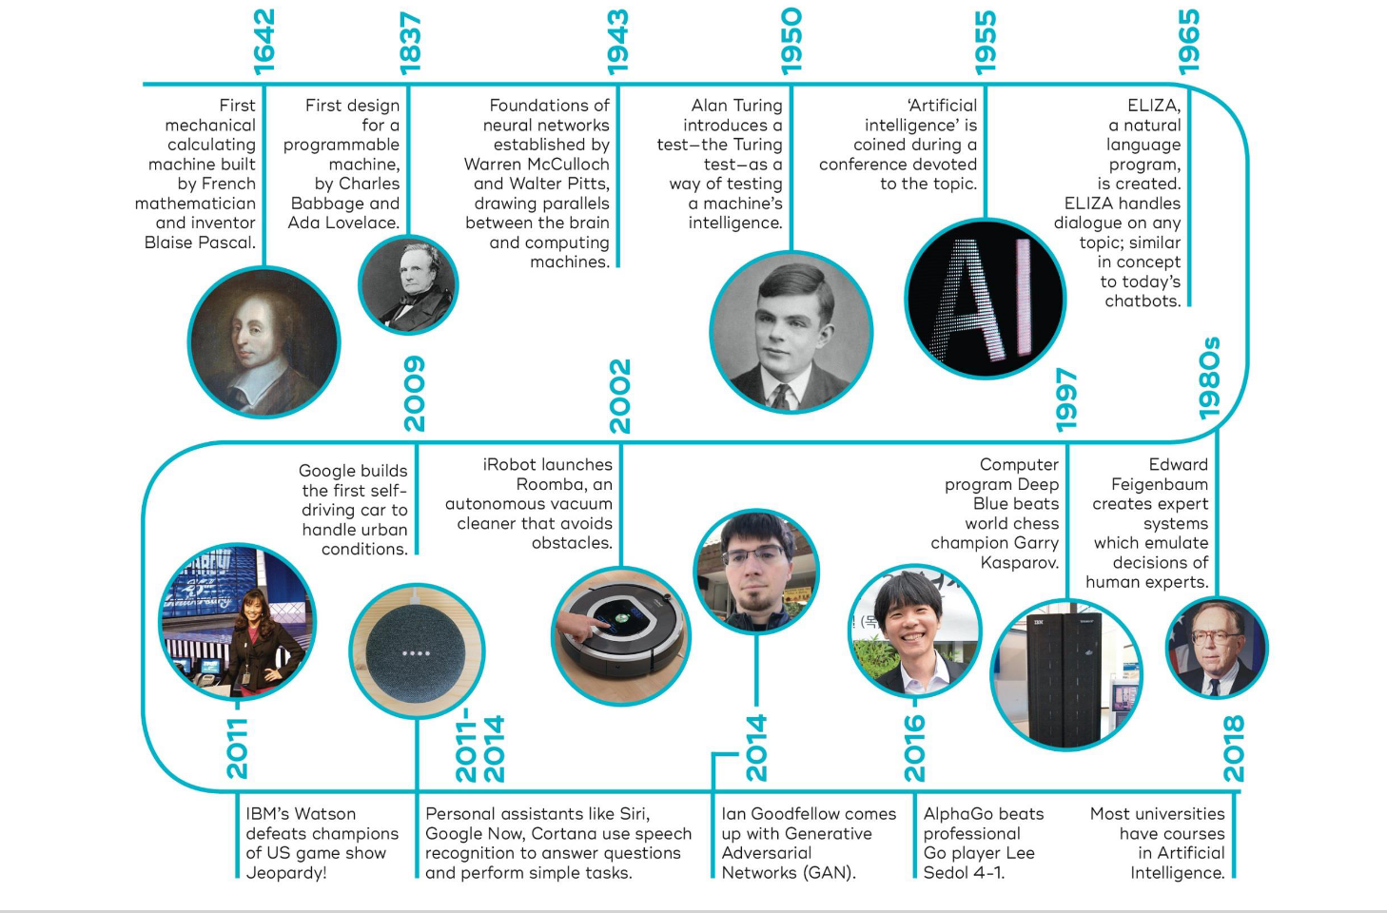
History of AI
23AM2405

Slide 34
Types of Intelligence
23AM2405
Intelligence | Description | Example
Linguistic intelligence | The ability to speak, recognize, and use mechanisms of phonology (speech sounds), syntax (grammar), and semantics (meaning). | Narrators, Orators
Musical intelligence | The ability to create, communicate with, and understand meanings made of sound, understanding of pitch, rhythm. | Musicians, Singers, Composers
Logical-mathematical intelligence | The ability of use and understand relationships in the absence of action or objects. Understanding complex and abstract ideas. | Mathematicians, Scientists
Spatial intelligence | The ability to perceive visual or spatial information, change it, and re-create visual images without reference to the objects, construct 3D images, and to move and rotate them. | Map readers, Astronauts, Physicists
Bodily-Kinesthetic intelligence | The ability to use complete or part of the body to solve problems or fashion products, control over fine and coarse motor skills, and manipulate the objects. | Players, Dancers
Intra-personal intelligence | The ability to distinguish among one’s own feelings, intentions, and motivations. | Saints
Interpersonal intelligence | The ability to recognize and make distinctions among other people’s feelings, beliefs, and intentions. | Mass Communicators, Interviewers

Slide 35
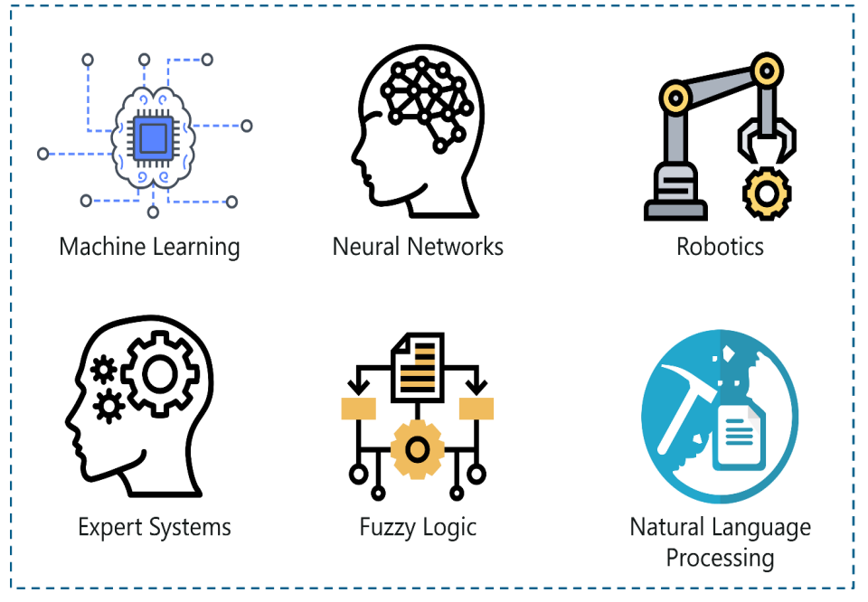
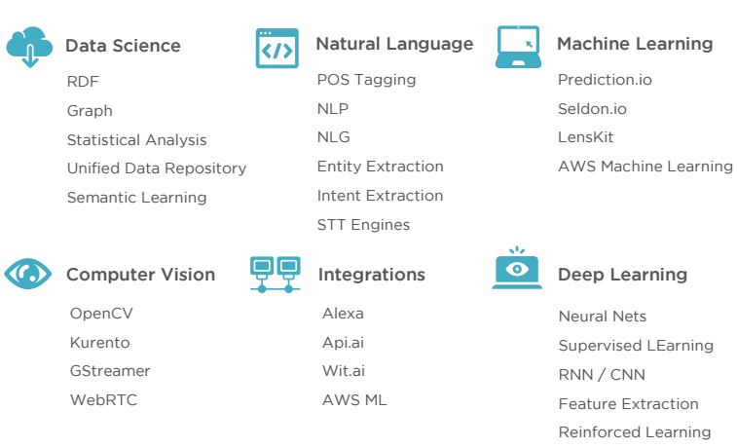
AI to Solve the Real World Problems
23AM2405

Slide 36
What is machine learning?
23AM2405
Machine learning is a branch of artificial intelligence (AI) and computer science which focuses on the use of data and algorithms to imitate the way that humans learn, gradually improving its accuracy.
ML is an important component of the growing field of data science. Through the use of statistical methods, algorithms are trained to make classifications or predictions, and to uncover key insights in data mining projects. These insights subsequently drive decision-making within applications and businesses, ideally impacting key growth metrics.
As big data continues to expand and grow, the market demand for data scientists will increase. They will be required to help identify the most relevant business questions and the data to answer them.

Slide 37
Machine Learning is the science of getting machines to interpret, process and analyze data in order to solve real-world problems.
Under Machine Learning there are three categories:
1.Supervised Learning
2.Unsupervised Learning
3.Reinforcement Learning

Slide 38
Supervised Learning
23AM2405
Supervised learning, as the name indicates, has the presence of a supervisor as a teacher.
Basically supervised learning is when we teach or train the machine using data that is well-labelled. Which means some data is already tagged with the correct answer.
Then, the machine will be provided with a new set of examples(data) so that the supervised learning algorithm analyses the training data(set of training examples) and produces a correct outcome from labeled data.

Slide 39

Supervised Learning
23AM2405
For instance, suppose you are given a basket filled with different kinds of fruits. Now the first step is to train the machine with all the different fruits one by one like this:
If the shape of the object is rounded and has a depression at the top, is red in color, then it will be labeled as –Apple.
If the shape of the object is a long curving cylinder having Green-Yellow color, then it will be labeled as –Banana.

Slide 40
Supervised Learning
23AM2405
After training the data, you have given a new separate fruit, say Banana from the basket, and asked to identify it.
Since the machine has already learned things from previous data and this time has to use it wisely. It will first classify the fruit with its shape and color and would confirm the fruit name as BANANA and put it in the Banana category. Thus the machine learns the things from training data(basket containing fruits) and then applies the knowledge to test data(new fruit).
Supervised learning is classified into two categories of algorithms:
Classification: A classification problem is when the output variable is a category, such as “Red” or “blue” , “disease” or “no disease”.
Regression: A regression problem is when the output variable is a real value, such as “dollars” or “weight”.

Slide 41
Types of Supervised Learning
Regression
Logistic Regression
Classification
Naive Bayes Classifiers
K-NN (k nearest neighbors)
Decision Trees
23AM2405
Support Vector Machine

Slide 42
Supervised Learning
23AM2405
Advantages:-
Supervised learning allows collecting data and produces data output from previous experiences.
Helps to optimize performance criteria with the help of experience.
Supervised machine learning helps to solve various types of real-world computation problems.
It performs classification and regression tasks.
It allows estimating or mapping the result to a new sample.
We have complete control over choosing the number of classes we want in the training data.

Slide 43
Supervised Learning
23AM2405
Disadvantages:-
Classifying big data can be challenging.
Training for supervised learning needs a lot of computation time. So, it requires a lot of time.
Supervised learning cannot handle all complex tasks in Machine Learning.
Computation time is vast for supervised learning.
It requires a labelled data set.
It requires a training process.

Slide 44
Unsupervised Learning
23AM2405
Unsupervised learning is the training of a machine using information that is neither classified nor labeled and allowing the algorithm to act on that information without guidance. Here the task of the machine is to group unsorted information according to similarities, patterns, and differences without any prior training of data.
Unlike supervised learning, no teacher is provided which means no training will be given to the machine. Therefore the machine is restricted to finding the hidden structure in unlabeled data by itself.

Slide 45

Unsupervised Learning
23AM2405
For instance, suppose it is given an image having both dogs and cats which it has never seen.
The machine has no idea about the features of dogs and cats, The Machine can’t categorize it as ‘dogs and cats ‘. But it can categorize them according to their similarities, patterns, and differences, i.e., we can easily categorize the above picture into two parts. The first may contain all pics having dogs in them and the second part may contain all pics having cats in them. Here you didn’t learn anything before, which means no training data or examples.
It allows the model to work on its own to discover patterns and information that was previously undetected. It mainly deals with unlabelled data.
Unsupervised learning is classified into two categories of algorithms:
Clustering: A clustering problem is where you want to discover the inherent groupings in the data, such as grouping customers by purchasing behavior.
Association: An association rule learning problem is where you want to discover rules that describe large portions of your data, such as people that buy X also tend to buy Y.

Slide 46
Types Unsupervised Learning
23AM2405
Clustering
Exclusive (partitioning)
Agglomerative
Overlapping
Probabilistic
Clustering Types:-
Hierarchical clustering
K-means clustering
Principal Component Analysis
Singular Value Decomposition
Independent Component Analysis

Slide 47
Supervised vs. Unsupervised Machine Learning:
23AM2405
Parameters | Supervised machine learning | Unsupervised machine learning
Input Data | Algorithms are trained using labeled data. | Algorithms are used against data that is not labeled
Computational Complexity | Simpler method | Computationally complex
Accuracy | Highly accurate | Less accurate
No. of classes | No. of classes is known | No. of classes is not known
Data Analysis | Uses offline analysis | Uses real-time analysis of data
Algorithms used | Linear and Logistics regression, Random forest, Support Vector Machine, Neural Network, etc. | K-Means clustering, Hierarchical clustering, Apriori algorithm, etc.

Slide 48
Unsupervised Learning
23AM2405
Parameters | Supervised machine learning | Unsupervised machine learning
Output | Desired output is given. | Desired output is not given.
Training data | Use training data to infer model. | No training data is used.
Complex model | It is not possible to learn larger and more complex models than with supervised learning. | It is possible to learn larger and more complex models with unsupervised learning.
Model | We can test our model. | We can not test our model.
Called as | Supervised learning is also called classification. | Unsupervised learning is also called clustering.
Example | Example: Optical character recognition. | Example: Find a face in an image.

Slide 49
Unsupervised Learning
23AM2405
Advantages of unsupervised learning:
It does not require training data to be labeled.
Dimensionality reduction can be easily accomplished using unsupervised learning.
Capable of finding previously unknown patterns in data.
Flexibility: Unsupervised learning is flexible in that it can be applied to a wide variety of problems, including clustering, anomaly detection, and association rule mining.
Exploration: Unsupervised learning allows for the exploration of data and the discovery of novel and potentially useful patterns that may not be apparent from the outset.
Low cost: Unsupervised learning is often less expensive than supervised learning because it doesn’t require labeled data, which can be time-consuming and costly to obtain.

Slide 50
Unsupervised Learning
23AM2405
Disadvantages of unsupervised learning :
Difficult to measure accuracy or effectiveness due to lack of predefined answers during training.
The results often have lesser accuracy.
The user needs to spend time interpreting and label the classes which follow that classification.
Lack of guidance: Unsupervised learning lacks the guidance and feedback provided by labeled data, which can make it difficult to know whether the discovered patterns are relevant or useful.
Sensitivity to data quality: Unsupervised learning can be sensitive to data quality, including missing values, outliers, and noisy data.
Scalability: Unsupervised learning can be computationally expensive, particularly for large datasets or complex algorithms, which can limit its scalability.

Slide 51
Reinforcement Learning
23AM2405
Reinforcement learning is about taking suitable action to maximize reward in a particular situation.
It is employed by various software and machines to find the best possible behavior or path it should take in a specific situation.
Reinforcement learning differs from supervised learning in a way that in supervised learning the training data has the answer key with it so the model is trained with the correct answer itself whereas in reinforcement learning, there is no answer but the reinforcement agent decides what to do to perform the given task. In the absence of a training dataset, it is bound to learn from its experience.
RL is the science of decision making. It is about learning the optimal behavior in an environment to obtain maximum reward. In RL, the data is accumulated from machine learning systems that use a trial-and-error method. Data is not part of the input that we would find in supervised or unsupervised machine learning.

Slide 52
Reinforcement Learning
23AM2405
Reinforcement learning uses algorithms that learn from outcomes and decide which action to take next. After each action, the algorithm receives feedback that helps it determine whether the choice it made was correct, neutral or incorrect. It is a good technique to use for automated systems that have to make a lot of small decisions without human guidance.
Reinforcement learning is an autonomous, self-teaching system that essentially learns by trial and error. It performs actions with the aim of maximizing rewards, or in other words, it is learning by doing in order to achieve the best outcomes.

Slide 53
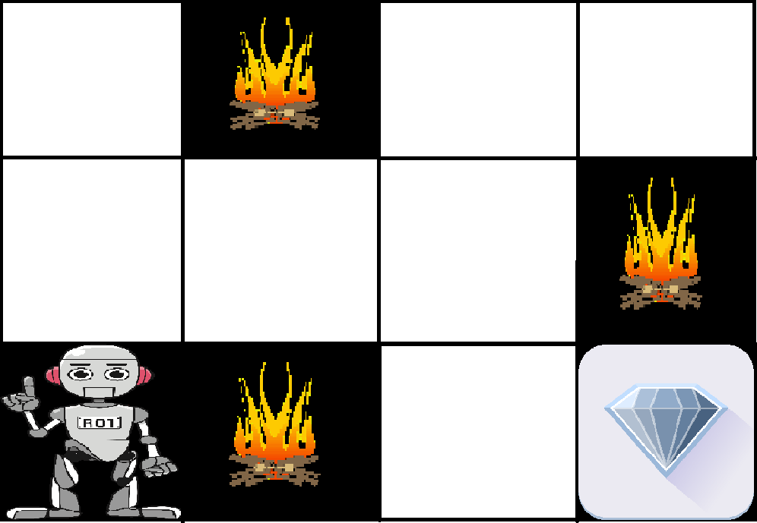
Reinforcement Learning
23AM2405
Example:
The problem is as follows: We have an agent and a reward, with many hurdles in between. The agent is supposed to find the best possible path to reach the reward. The following problem explains the problem more easily.
The above image shows the robot, diamond, and fire. The goal of the robot is to get the reward that is the diamond and avoid the hurdles that are fired. The robot learns by trying all the possible paths and then choosing the path which gives him the reward with the least hurdles. Each right step will give the robot a reward and each wrong step will subtract the reward of the robot. The total reward will be calculated when it reaches the final reward that is the diamond.

Slide 54
Reinforcement Learning
23AM2405
Main points in Reinforcement learning –
Input: The input should be an initial state from which the model will start
Output: There are many possible outputs as there are a variety of solutions to a particular problem
Training: The training is based upon the input, The model will return a state and the user will decide to reward or punish the model based on its output.
The model keeps continues to learn.
The best solution is decided based on the maximum reward.

Slide 55
Reinforcement Learning
23AM2405
Reinforcement learning | Supervised learning
Reinforcement learning is all about making decisions sequentially. In simple words, we can say that the output depends on the state of the current input and the next input depends on the output of the previous input | In Supervised learning, the decision is made on the initial input or the input given at the start
In Reinforcement learning decision is dependent, So we give labels to sequences of dependent decisions | In supervised learning the decisions are independent of each other so labels are given to each decision.
Example: Chess game,text summarization | Example: Object recognition,spam detetction

Slide 56
Types of Reinforcement Learning
23AM2405
There are two types of Reinforcement:
Positive: Positive Reinforcement is defined as when an event, occurs due to a particular behavior, increases the strength and the frequency of the behavior. In other words, it has a positive effect on behavior.
Advantages of reinforcement learning are:
Maximizes Performance
Sustain Change for a long period of time
Too much Reinforcement can lead to an overload of states which can diminish the results
Negative: Negative Reinforcement is defined as strengthening of behavior because a negative condition is stopped or avoided.
Advantages of reinforcement learning:
Increases Behavior
Provide defiance to a minimum standard of performance
It Only provides enough to meet up the minimum behavior

Slide 57
Reinforcement Learning
23AM2405
Application of Reinforcement Learnings
Robotics: Robots with pre-programmed behavior are useful in structured environments, such as the assembly line of an automobile manufacturing plant, where the task is repetitive in nature.
A master chess player makes a move. The choice is informed both by planning, anticipating possible replies and counter replies.
An adaptive controller adjusts parameters of a petroleum refinery’s operation in real time.

Slide 58
Advantages of Reinforcement Learning
23AM2405
1. Reinforcement learning can be used to solve very complex problems that cannot be solved by conventional techniques.
2. The model can correct the errors that occurred during the training process.
3. In RL, training data is obtained via the direct interaction of the agent with the environment
4. Reinforcement learning can handle environments that are non-deterministic, meaning that the outcomes of actions are not always predictable. This is useful in real-world applications where the environment may change over time or is uncertain.
5. Reinforcement learning can be used to solve a wide range of problems, including those that involve decision making, control, and optimization.
6. Reinforcement learning is a flexible approach that can be combined with other machine learning techniques, such as deep learning, to improve performance.

Slide 59
Disadvantages of Reinforcement Learning
23AM2405
1. Reinforcement learning is not preferable to use for solving simple problems.
2. Reinforcement learning needs a lot of data and a lot of computation
3. Reinforcement learning is highly dependent on the quality of the reward function. If the reward function is poorly designed, the agent may not learn the desired behavior.
4. Reinforcement learning can be difficult to debug and interpret. It is not always clear why the agent is behaving in a certain way, which can make it difficult to diagnose and fix problems.

Slide 60

Activity / Assignment
23AM2405
Write up / chart preparation on Machine Learning three categories.
1. Supervised Learning
2. Unsupervised Learning
3. Reinforcement Learning

Slide 61
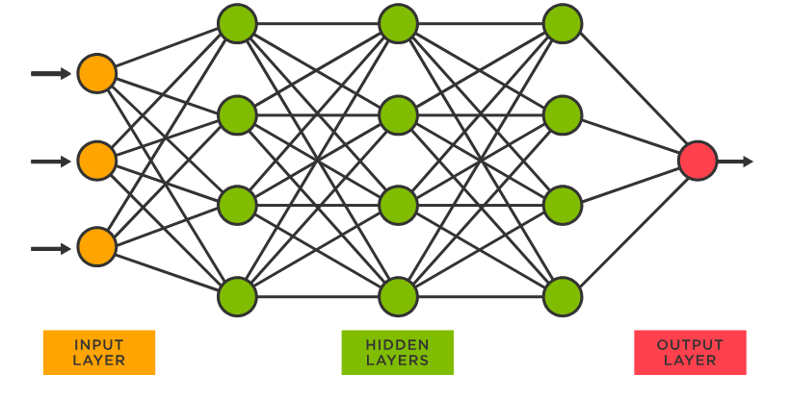
Neural Network and its important
23AM2405
A neural network is a method in artificial intelligence that teaches computers to process data in a way that is inspired by the human brain.
It is a type of machine learning process, called deep learning, that uses interconnected nodes or neurons in a layered structure that resembles the human brain.
It creates an adaptive system that computers use to learn from their mistakes and improve continuously. Thus, artificial neural networks attempt to solve complicated problems, like summarizing documents or recognizing faces, with greater accuracy.

Slide 62
23AM2405
Neural networks can help computers make intelligent decisions with limited human assistance. This is because they can learn and model the relationships between input and output data that are nonlinear and complex. For instance, they can do the following tasks.
Make generalizations and inferences
Neural networks can comprehend unstructured data and make general observations without explicit training. For instance, they can recognize that two different input sentences have a similar meaning:
Can you tell me how to make the payment?
How do I transfer money?
A neural network would know that both sentences mean the same thing. Or it would be able to broadly recognize that Baxter Road is a place, but Baxter Smith is a person’s name.

Slide 63
Neural Networks used for
23AM2405
Neural networks have several use cases across many industries, such as the following:
Medical diagnosis by medical image classification
Targeted marketing by social network filtering and behavioral data analysis
Financial predictions by processing historical data of financial instruments
Electrical load and energy demand forecasting
Process and quality control
Chemical compound identification

Slide 64
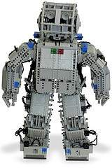
Robotics
23AM2405
Robotics is a domain of artificial intelligence that deals with the study of creating intelligent and efficient robots.
Robots are artificial agents acting in real-world environments.
Robots are aimed at manipulating objects by perceiving, picking, moving, modifying the physical properties of an object, destroying it, or having an effect thereby freeing manpower from doing repetitive functions without getting bored, distracted, or exhausted.
Robotics: Robotics is a branch of AI, which is composed of Electrical Engineering, Mechanical Engineering, and Computer Science for designing, construction, and application of robots.

Slide 65
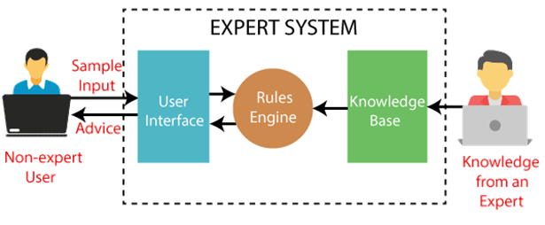
Expert System
23AM2405
An expert system is an AI-based computer system that learns and reciprocates the decision-making ability of a human expert.
These are Soft wares used for decision making . Automated Reasoning and Theorem Proving.
Expert systems use if-then logical notations to solve complex problems.
It does not rely on conventional procedural programming.
Expert systems are mainly used in information management, medical facilities, loan analysis, virus detection and so on.

Slide 66
Fuzzy logic
23AM2405
In artificial intelligence (AI) systems, fuzzy logic is used to imitate human reasoning and cognition. Rather than strictly binary cases of truth, fuzzy logic includes 0 and 1 as extreme cases of truth but with various intermediate degrees of truth.
Fuzzy logic is well-suited for the following:
Engineering for decisions without clear certainties and uncertainties, or with imprecise data -- such as with natural language processing technologies; and
Regulating and controlling machine outputs, according to multiple inputs/input variables -- such as with temperature control systems.
IBM's Watson supercomputer is one of the most prominent examples of how variations of fuzzy logic and fuzzy semantics are used.
Watson is an IBM supercomputer that combines artificial intelligence (AI) and sophisticated analytical software...

Slide 67
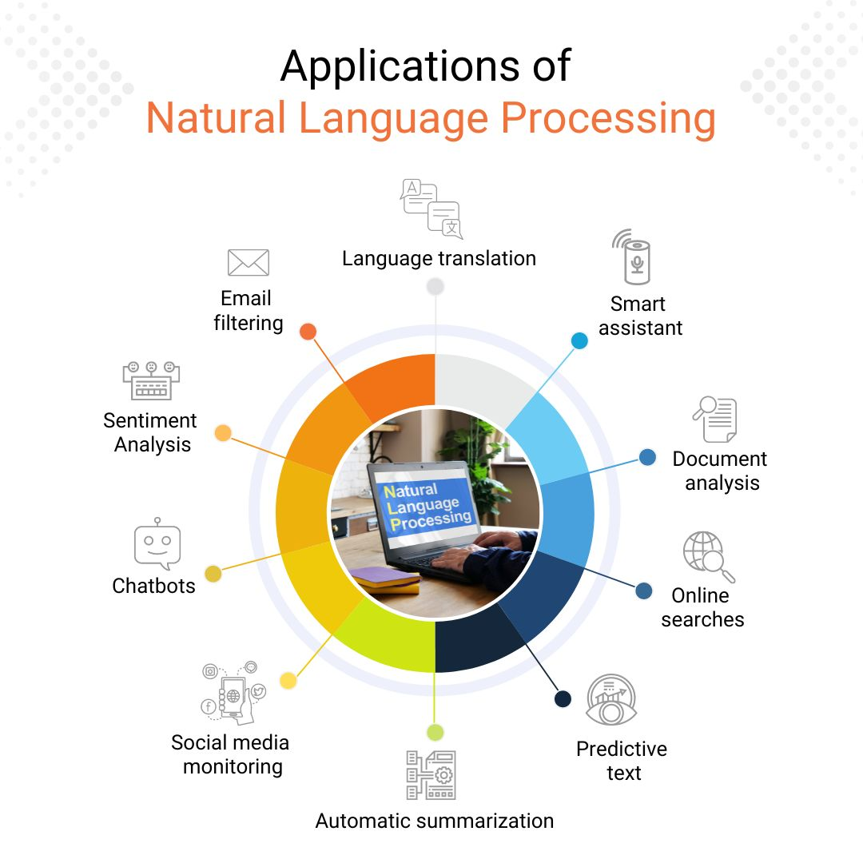
Natural Language Processing
23AM2405
Natural Language Processing (NLP) refers to the science of drawing insights from natural human language in order to communicate with machines and grow businesses.
One of the older and best-known examples of NLP is spam detection, which looks at the subject line and text of an email and decides if it's junk.
Current approaches to NLP are based on machine learning. NLP tasks include text translation, sentiment analysis and speech recognition.
Amazon uses NLP to understand customer reviews and improve user experience.

Slide 68
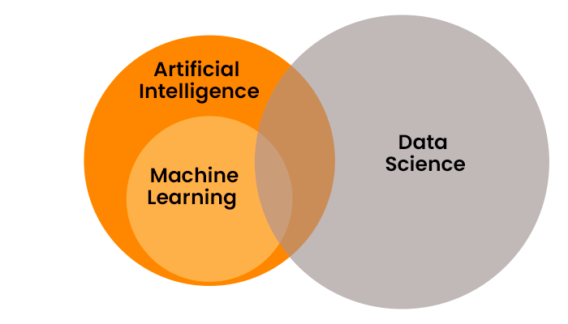
Data science
23AM2405
Data science combines math and statistics, specialized programming, advanced analytics, artificial intelligence (AI), and machine learning with specific subject matter expertise to uncover actionable insights hidden in an organization’s data. These insights can be used to guide decision making and strategic planning.

Slide 69
AI Techniques
23AM2405
Artificial Intelligence (AI) techniques are methods, algorithms, and approaches used to create intelligent systems capable of learning, reasoning, and problem-solving. These techniques enable AI systems to perform tasks that would otherwise require human intelligence.
4 types of Artificial Intelligence Techniques:
Machine Learning (ML)
Machine Vision or Computer Vision
Automation and Robotics
Natural Language Processing (NLP)

Slide 70
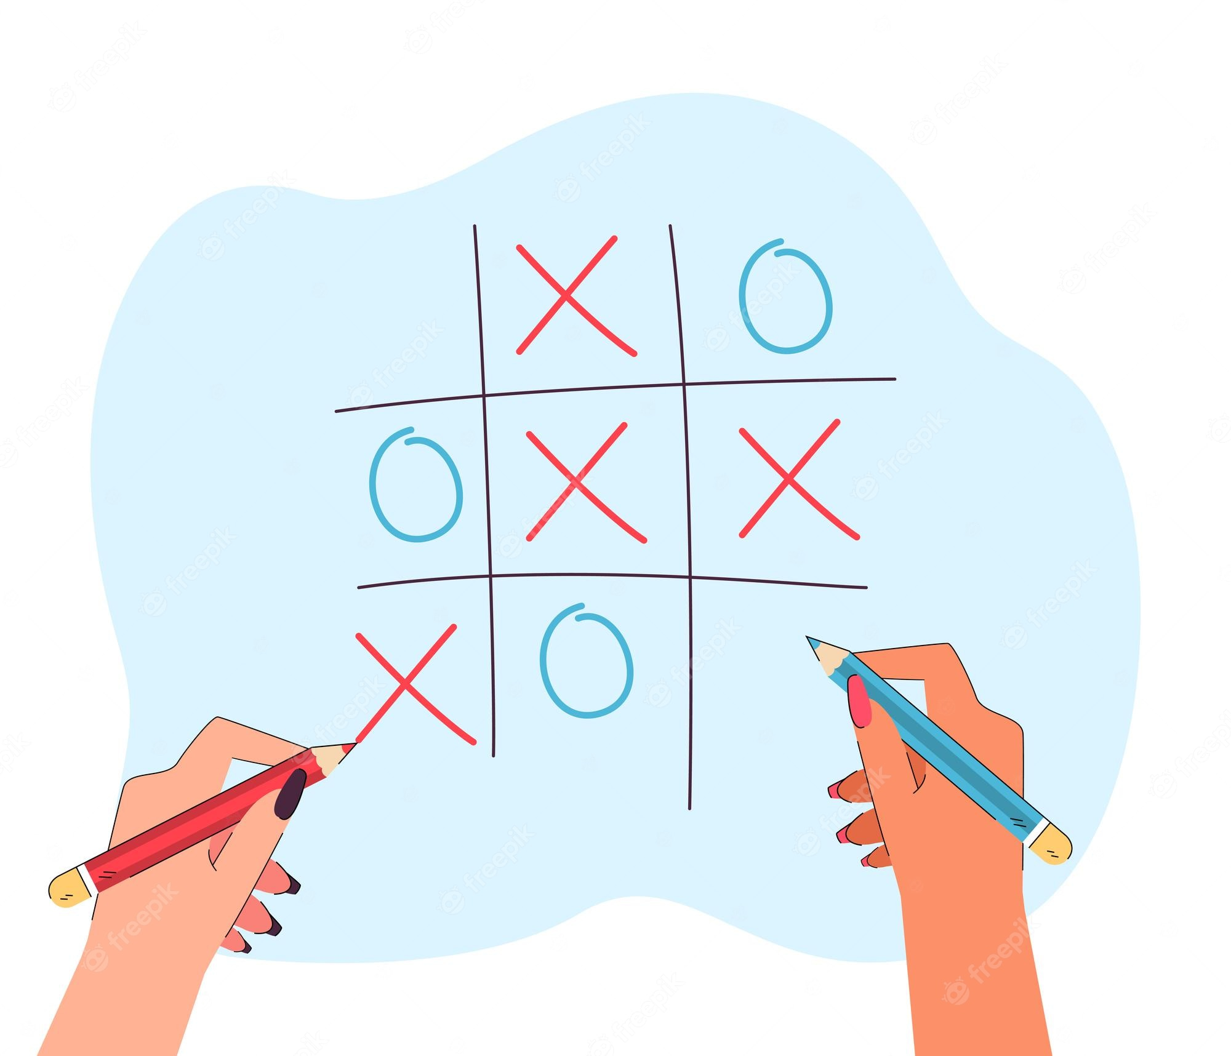

Fun program
23AM2405
Implement an python code and explain for its working- Tic tac toe –
Submission of Video / YouTube link 3-5min video with description (English/ Hindi / kannada sub titles)

Slide 71
AI Agents
23AM2405
In artificial intelligence, an agent is a computer program or system that is designed to perceive its environment, make decisions and take actions to achieve a specific goal or set of goals. The agent operates autonomously, meaning it is not directly controlled by a human operator.
An AI system can be defined as the study of the rational agent and its environment. The agents sense the environment through sensors and act on their environment through actuators. An AI agent can have mental properties such as knowledge, belief, intention, etc.
An agent can be anything that perceiveits environment through sensors and act upon that environment through actuators. An Agent runs in the cycle of perceiving, thinking, and acting.

Slide 72
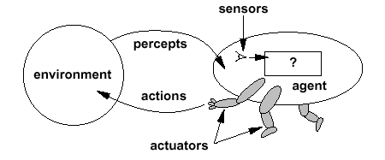
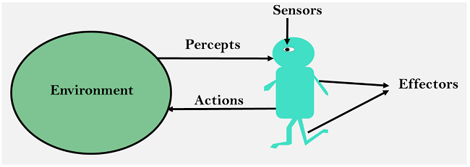
23AM2405
An agent can be:
Human-Agent: A human agent has eyes, ears, and other organs which work for sensors and hand, legs, vocal tract work for actuators.
Robotic Agent: A robotic agent can have cameras, infrared range finder, NLP for sensors and various motors for actuators.
Software Agent: Software agent can have keystrokes, file contents as sensory input and act on those inputs and display output on the screen.

Slide 73
23AM2405
Before moving forward, we should first know about sensors, effectors, and actuators.
Sensor: Sensor is a device which detects the change in the environment and sends the information to other electronic devices. An agent observes its environment through sensors.
Actuators: Actuators are the component of machines that converts energy into motion. The actuators are only responsible for moving and controlling a system. An actuator can be an electric motor, gears, rails, etc.
Effectors: Effectors are the devices which affect the environment. Effectors can be legs, wheels, arms, fingers, wings, fins, and display screen.

Slide 74
23AM2405
Agents can be classified into different types based on their characteristics, such as whether they are reactive or proactive, whether they have a fixed or dynamic environment, and whether they are single or multi-agent systems.
Reactive agents | Multi-agent systems
Reactive agents are those that respond to immediate stimuli from their environment and take actions based on those stimuli. Proactive agents, on the other hand, take initiative and plan ahead to achieve their goals. The environment in which an agent operates can also be fixed or dynamic. Fixed environments have a static set of rules that do not change, while dynamic environments are constantly changing and require agents to adapt to new situations. | Multi-agent systems involve multiple agents working together to achieve a common goal. These agents may have to coordinate their actions and communicate with each other to achieve their objectives. Agents are used in a variety of applications, including robotics, gaming, and intelligent systems. They can be implemented using different programming languages and techniques, including machine learning and natural language processing.

Slide 75
Structure of an AI Agent
23AM2405
To understand the structure of Intelligent Agents, we should be familiar with Architecture and Agent programs. Architecture is the machinery that the agent executes on. It is a device with sensors and actuators, for example, a robotic car, a camera, and a PC. An agent program is an implementation of an agent function. An agent function is a map from the percept sequence(history of all that an agent has perceived to date) to an action.
Architecture
Agent Program
Agent

Slide 76
Example of Agents with their PEAS representation
23AM2405
Performance: Safety, time, legal drive, comfort
Environment: Roads, other vehicles, road signs, pedestrian
Actuators: Steering, accelerator, brake, signal, horn
Sensors: Camera, GPS, speedometer, odometer, accelerometer, sonar.
Agent | Performance measure | Environment | Actuators | Sensors
1. Medical Diagnose | Healthy patient Minimized cost | Patient Hospital Staff | Tests Treatments | Keyboard (Entry of symptoms)
2. Vacuum Cleaner | Cleanness Efficiency Battery life Security | Room Table Wood floor Carpet Various obstacles | Wheels Brushes Vacuum Extractor | Camera Dirt detection sensor Cliff sensor Bump Sensor Infrared Wall Sensor
3. Part -picking Robot | Percentage of parts in correct bins. | Conveyor belt with parts, Bins | Jointed Arms Hand | Camera Joint angle sensors.

Slide 77
Types of Agents
23AM2405
1
Simple Reflex Agents
2
Model-Based Reflex Agents
3
Goal-Based Agents
4
Utility-Based Agents
5
Learning Agent
6
Multi-agent Systems
7
Hierarchical Agents

Slide 78
Simple Reflex Agents
23AM2405
The Simple reflex agents are the simplest agents. These agents make decisions on the basis of the current percepts and ignore the rest of the percept history.
These agents only succeed in the fully observable environment.
The Simple reflex agent does not consider any part of percept history during their decision and action process.
The Simple reflex agent works on Condition-action rule, which means it maps the current state to action. Such as a Room Cleaner agent, it works only if there is dirt in the room.
Problems for the simple reflex agent design approach:
They have very limited intelligence
They do not have knowledge of non-perceptual parts of the current state (background knowledge).
Not adaptive to changes in the environment.

Slide 79
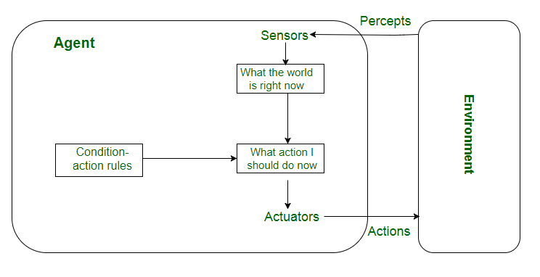
23AM2405

Slide 80
Model-Based Reflex Agents
23AM2405
The Model-based agent can work in a partially observable environment, and track the situation.
A model-based agent has two important factors:
Model: It is knowledge about "how things happen in the world," so it is called a Model-based agent.
Internal State: It is a representation of the current state based on percept history.
These agents have the model, "which is knowledge of the world" and based on the model they perform actions.
Updating the agent state requires information about:
How the world evolves?
How the agent's action affects the world?
Self-driving cars are a great example of a model-based reflex agent. The car is equipped with sensors that detect obstacles, such as car brake, lights in front of them or pedestrians walking on the sidewalk. As it drives, these sensors feed percepts into the car's memory and internal model of its environment.

Slide 81
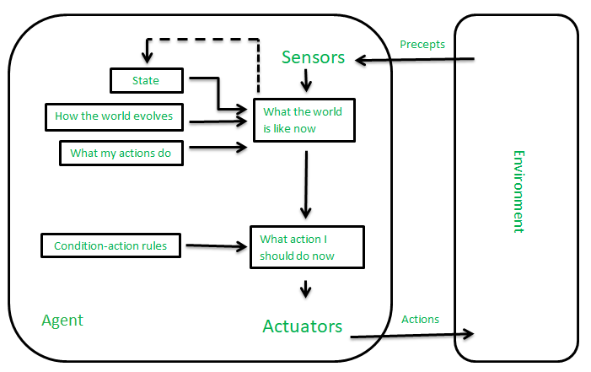
Model-Based Reflex Agents
23AM2405

Slide 82
Goal-Based Agents
23AM2405
The knowledge of the current state environment is not always sufficient to decide for an agent to what to do.
The agent needs to know its goal which describes desirable situations.
Goal-based agents expand the capabilities of the model-based agent by having the "goal" information.
They choose an action, so that they can achieve the goal.
These agents may have to consider a long sequence of possible actions before deciding whether the goal is achieved or not. Such considerations of different scenario are called searching and planning, which makes an agent proactive.

Slide 83
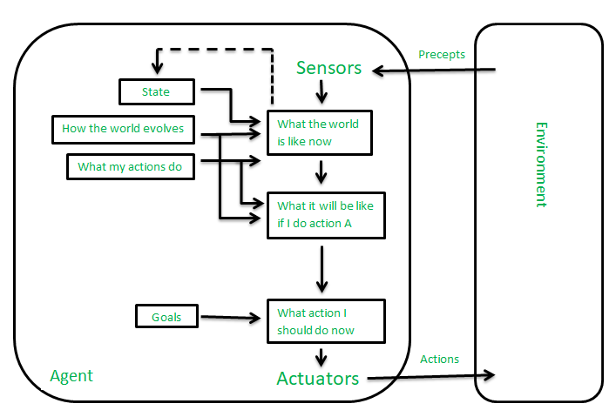
Goal-Based Agents
23AM2405

Slide 84
Utility-Based Agents
23AM2405
These agents are similar to the goal-based agent but provide an extra component of utility measurement which makes them different by providing a measure of success at a given state.
Utility-based agent act based not only goals but also the best way to achieve the goal.
The Utility-based agent is useful when there are multiple possible alternatives, and an agent has to choose in order to perform the best action.
The utility function maps each state to a real number to check how efficiently each action achieves the goals.

Slide 85
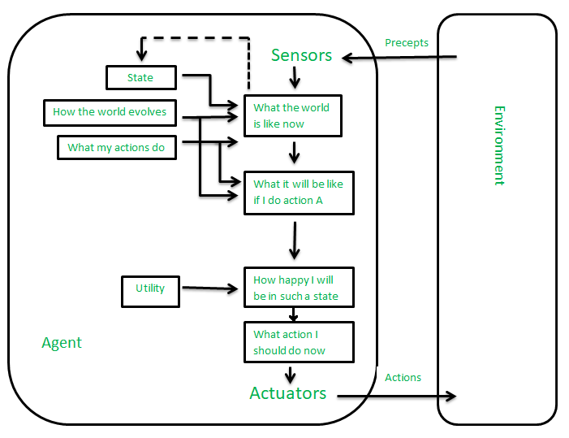
Utility-Based Agents
23AM2405

Slide 86
Learning Agent
23AM2405
A learning agent in AI is the type of agent that can learn from its past experiences or it has learning capabilities. It starts to act with basic knowledge and then is able to act and adapt automatically through learning.
It has mainly four conceptual components, which are:
Learning element: It is responsible for making improvements by learning from the environment.
Critic: The learning element takes feedback from critics which describes how well the agent is doing with respect to a fixed performance standard.
Performance element: It is responsible for selecting external action.
Problem Generator: This component is responsible for suggesting actions that will lead to new and informative experiences.

Slide 87
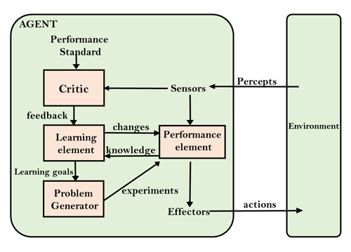
Learning Agent
23AM2405

Slide 88
Multi-agent Systems
23AM2405
These agents interact with other agents to achieve a common goal. They may have to coordinate their actions and communicate with each other to achieve their objective.
A multi-agent system (MAS) is a system composed of multiple interacting agents that are designed to work together to achieve a common goal. These agents may be autonomous or semi-autonomous and are capable of perceiving their environment, making decisions, and taking action to achieve the common objective.
MAS can be used in a variety of applications, including transportation systems, robotics, and social networks.
They can help improve efficiency, reduce costs, and increase flexibility in complex systems.

Slide 89
Hierarchical Agents
23AM2405
These agents are organized into a hierarchy, with high-level agents overseeing the behavior of lower-level agents. The high-level agents provide goals and constraints, while the low-level agents carry out specific tasks. Hierarchical agents are useful in complex environments with many tasks and sub-tasks.

Slide 90
Uses of Agents
23AM2405
Agents are used in a wide range of applications in artificial intelligence, including:
Robotics: Agents can be used to control robots and automate tasks in manufacturing, transportation, and other industries.
Smart homes and buildings: Agents can be used to control heating, lighting, and other systems in smart homes and buildings, optimizing energy use and improving comfort.
Transportation systems: Agents can be used to manage traffic flow, optimize routes for autonomous vehicles, and improve logistics and supply chain management.
Healthcare: Agents can be used to monitor patients, provide personalized treatment plans, and optimize healthcare resource allocation.
Finance: Agents can be used for automated trading, fraud detection, and risk management in the financial industry.

Slide 91
Uses of Agents
23AM2405
Games: Agents can be used to create intelligent opponents in games and simulations, providing a more challenging and realistic experience for players.
Natural language processing: Agents can be used for language translation, question answering, and chatbots that can communicate with users in natural language.
Cybersecurity: Agents can be used for intrusion detection, malware analysis, and network security.
Environmental monitoring: Agents can be used to monitor and manage natural resources, track climate change, and improve environmental sustainability.
Social media: Agents can be used to analyze social media data, identify trends and patterns, and provide personalized recommendations to users.

Slide 92
Agent Environment in AI
An environment is everything in the world which surrounds the agent, but it is not a part of an agent itself.
An environment can be described as a situation in which an agent is present.
The environment is where agent lives, operate and provide the agent with something to sense and act upon it.

Slide 93
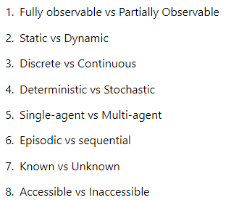
Features of Environment
An environment can have various features from the point of view of an agent:

Slide 94
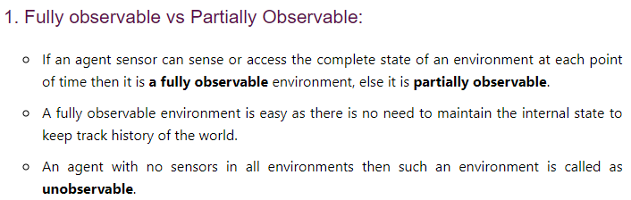
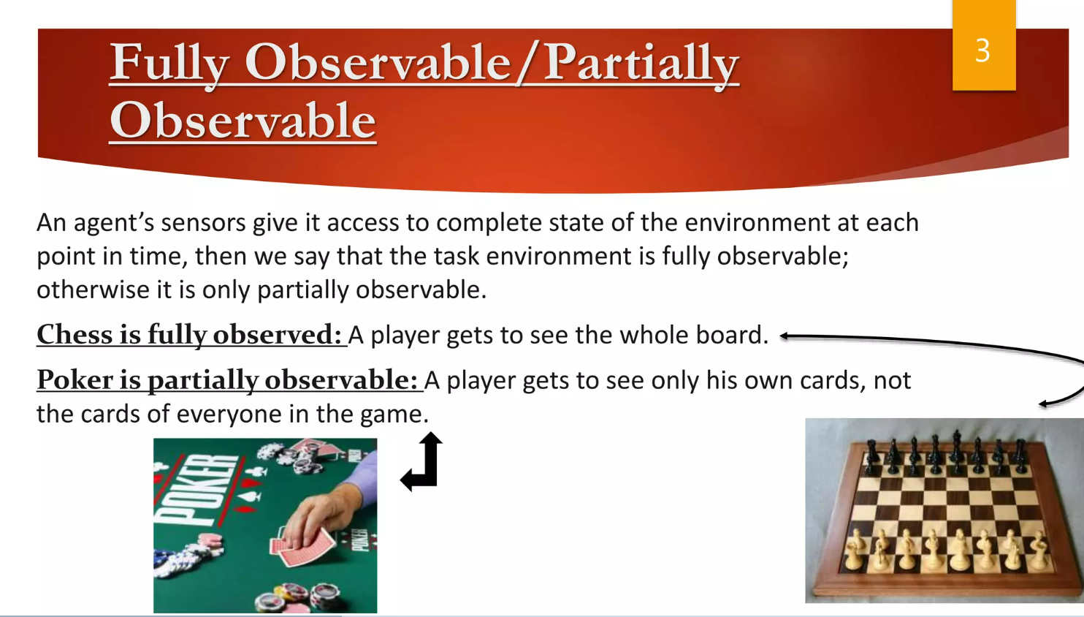
Features of Environment

Slide 95
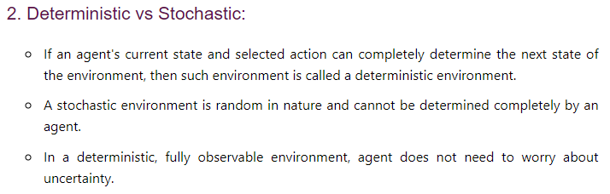
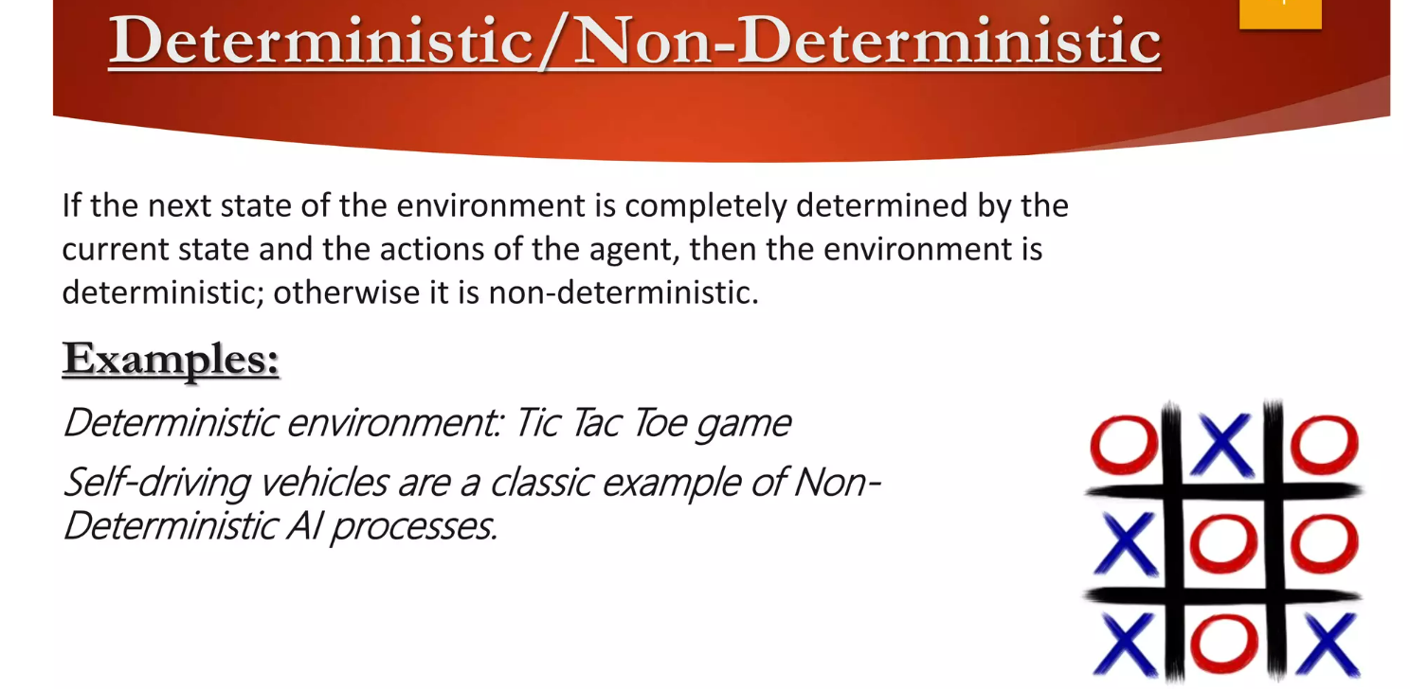
Features of Environment

Slide 96
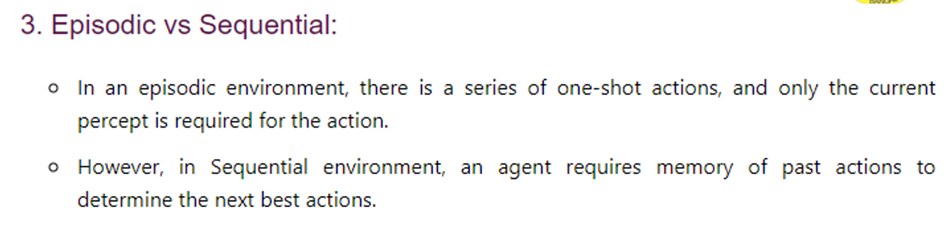
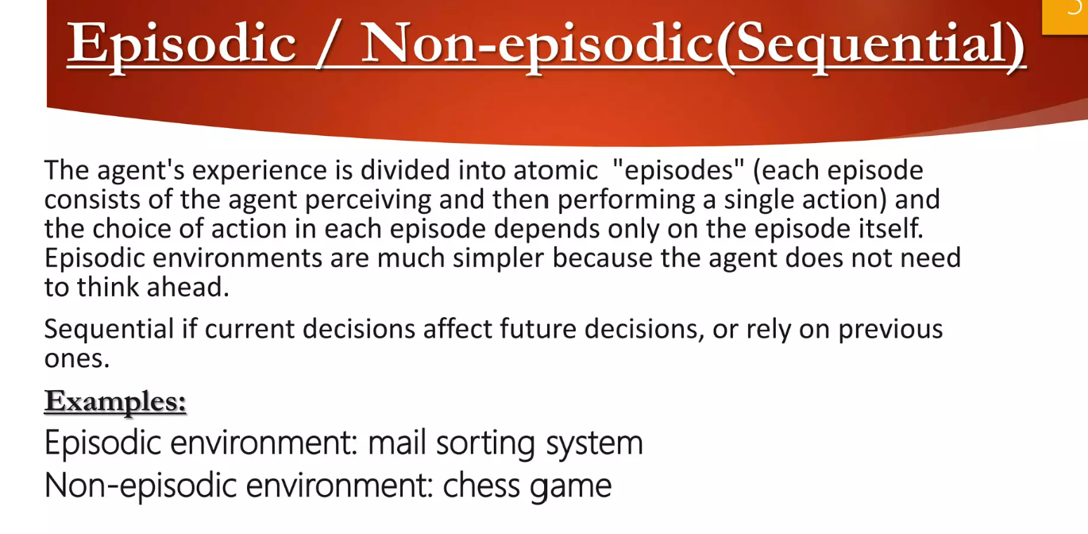
Features of Environment
Notes:
In an episodic environment, the agent's experience is divided into episodes which consist of a percept sequence and an action. Since episodes are independent of one another and the agent doesn't need to know the effect of its actions.

Slide 97
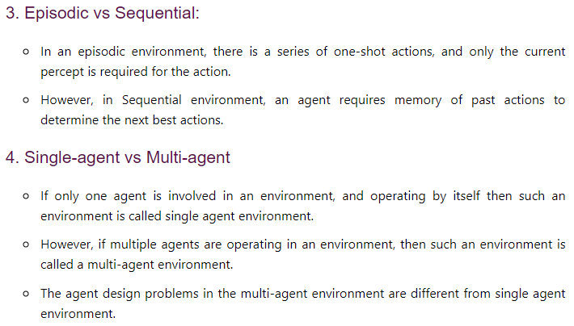
Features of Environment
Notes:
In an episodic environment, the agent's experience is divided into episodes which consist of a percept sequence and an action. Since episodes are independent of one another and the agent doesn't need to know the effect of its actions.

Slide 98
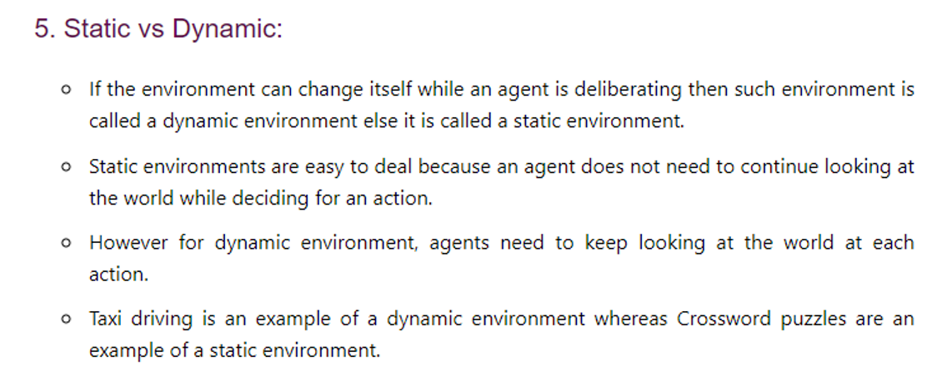
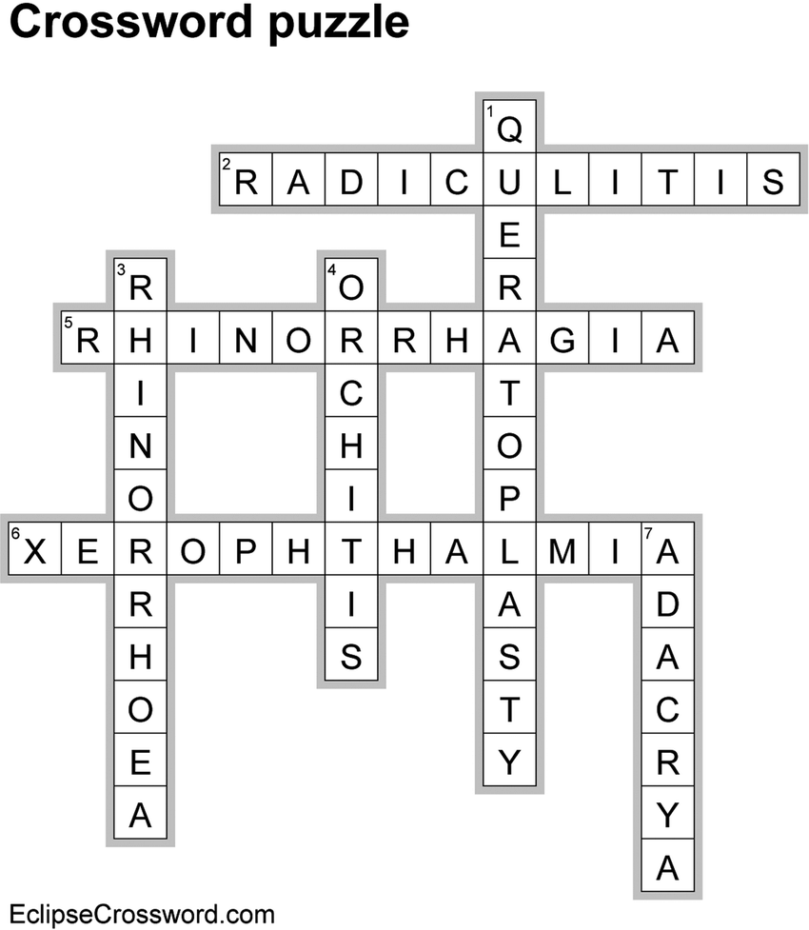
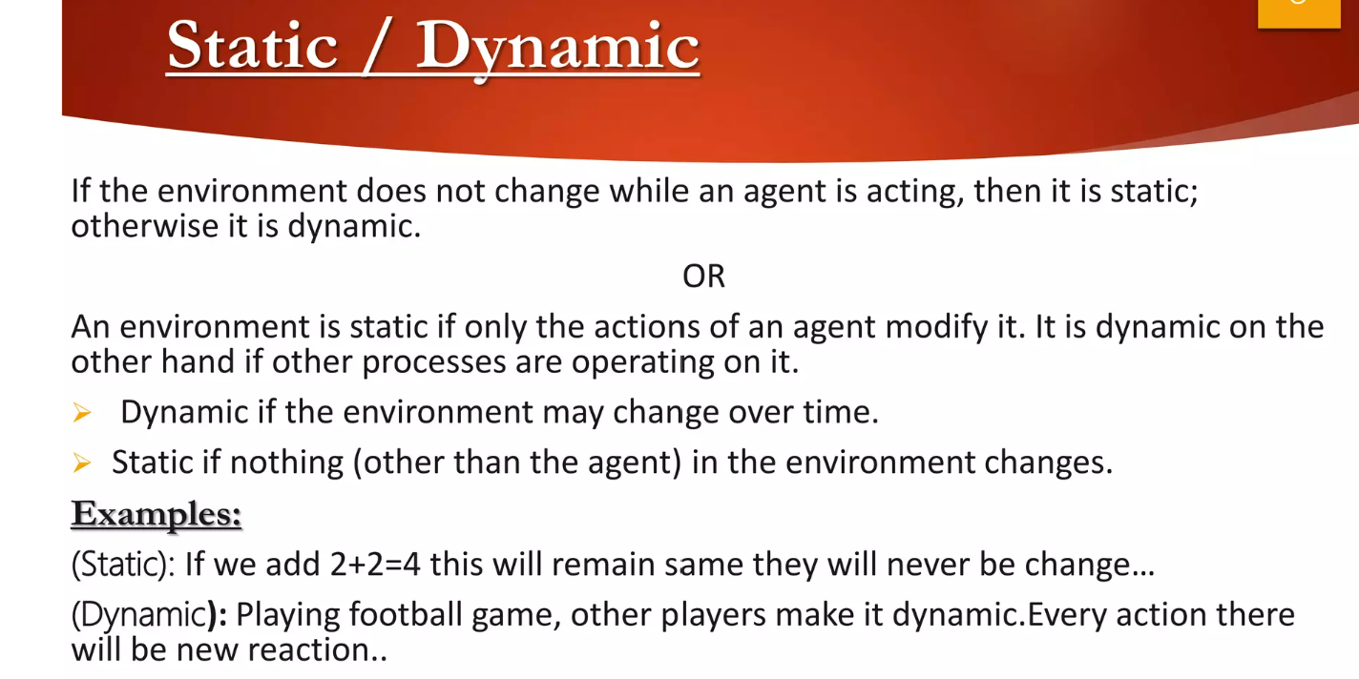
Features of Environment
Notes:
Delibration-discussion or thinking about something in detail.
An environment is dynamic if it changes while an agent is in the process of responding to a percept sequence. It is static if it does not change while the agent is deciding on an action i.e the agent does not to keep in touch with time. An environment is semidynamic if it does not change with timebut he agent's performace score does.
If the number of percepts and actions in the environment is limited and distinct then the environment is said to be discrete.eg A chess board.

Slide 99
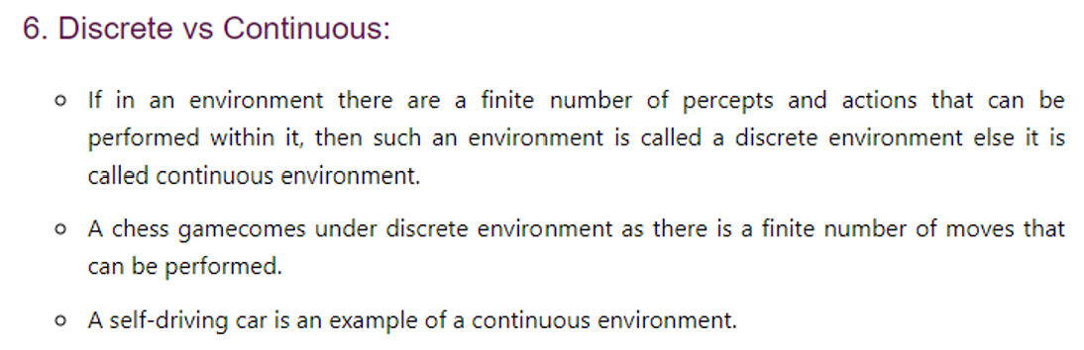
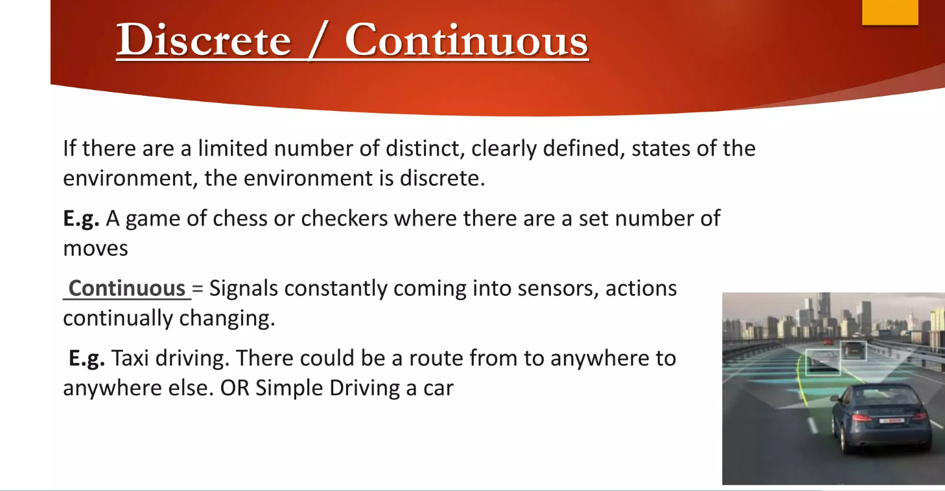
Features of Environment
Notes:
Delibration-discussion or thinking about something in detail.
An environment is dynamic if it changes while an agent is in the process of responding to a percept sequence. It is static if it does not change while the agent is deciding on an action i.e the agent does not to keep in touch with time. An environment is semidynamic if it does not change with timebut he agent's performace score does.
If the number of percepts and actions in the environment is limited and distinct then the environment is said to be discrete.eg A chess board.

Slide 100
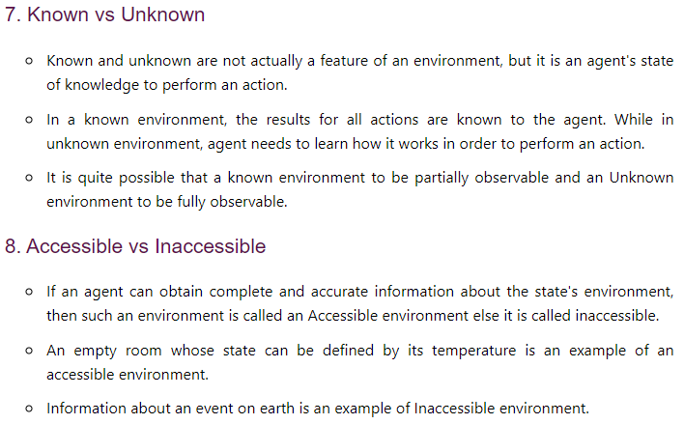
Features of Environment

Slide 101
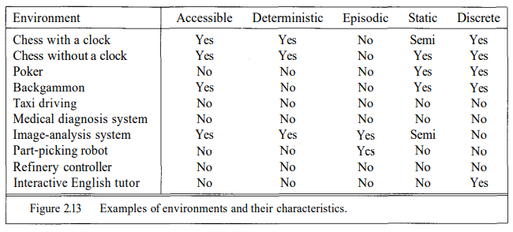
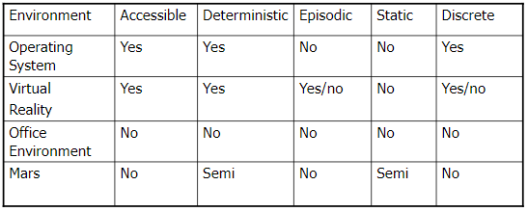
Environment Types

Slide 102
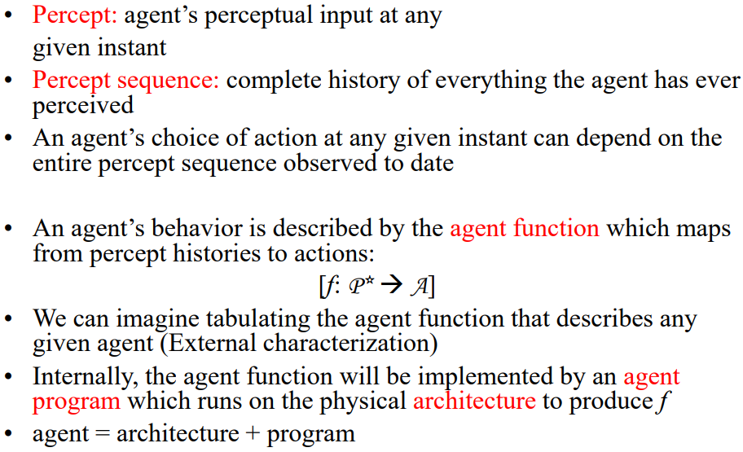
Agents and Environment

Slide 103
A Windshield Wiper Agent
How do we design a agent that can wipe the windshields when needed?
Goals?
Percepts?
Sensors?
Effectors?
Actions?
Environment?
Goals: Keep windshields clean & maintain visibility
Percepts: Raining, Dirty
Sensors: Camera (moist sensor)
Effectors: Wipers (left, right, back)
Actions: Off, Slow, Medium, Fast
Environment: Inner city, freeways, highways, weather …

Slide 104

Activity / Assignment
23AM2405
Role of Artificial Intelligence in Online Casino Industry.
Can AI make games.

Slide 105
Problem Space and Search
23AM2405
State space search is a problem-solving technique used in Artificial Intelligence (AI) to find the solution path from the initial state to the goal state by exploring the various states. The state space search approach searches through all possible states of a problem to find a solution. It is an essential part of Artificial Intelligence and is used in various applications, from game-playing algorithms to natural language processing.

Slide 106
Problem of building a system
23AM2405
To solve the problem of building a system you should take the following steps:
Define the problem accurately including detailed specifications and what constitutes a suitable solution.
Scrutinize the problem carefully, for some features may have a central affect on the chosen method of solution.
Segregate and represent the background knowledge needed in the solution of the problem.
Choose the best solving techniques for the problem to solve a solution.

Slide 107
Problem-solving is a process of generating solutions from observed data.
23AM2405
A Problem is characterized by a set of goals,
A set of objects, and
A set of operations.
These could be ill-defined and may evolve during problem-solving.
A Problem space is an abstract space.
A problem space encompasses all valid states that can be generated by the application of any combination of operators on any combination of objects.
The problem space may contain one or more solutions. A solution is a combination of operations and objects that achieve the goals.
A search refers to the search for a solution in a problem space.
Search proceeds with different types of search control strategies
The depth-first search and breadth-first search are the two common search strategies.

Slide 108
AI - General Problem Solving
23AM2405
Problem-solving has been the key area of concern for Artificial Intelligence.
Problem-solving is a process of generating solutions from observed or given data. It is however not always possible to use direct methods (i.e. go directly from data to solution). Instead, problem-solving often needs to use indirect or model-based methods.
General Problem Solver (GPS) was a computer program created in 1957 by Simon and Newell to build a universal problem solver machine. GPS works on logic machines. GPS in principle can solve any formalized symbolic problem, such as theorems proof and geometric problems and chess playing. GPS solved many simple problems, such as the Towers of Hanoi, that could be sufficiently formalized, but GPS could not solve any real-world problems.

Slide 109
23AM2405
To build a system to solve a particular problem, we need to:
Define the problem precisely find input situations as well as final situations for an acceptable solution to the problem
Analyze the problem find few important features that may have impact on the appropriateness of various possible techniques for solving the problem
Isolate and represent task knowledge necessary to solve the problem
Choose the best problem-solving technique(s) and apply to the particular problem

Slide 110
Problem definitions
23AM2405
A Problem is defined by its ‘elements’ and their ‘relations. To provide a formal description of a problem. We need to do the following:
a. Define a state space that contains all the possible configurations of the relevant objects, including some impossible ones.
b. Specify one or more states that describe possible situations, from which the problem-solving process may start. These states are called initial states.
c. Specify one or more states that would be acceptable solution to the problem.

Slide 111
Goal states
23AM2405
Specify a set of rules that describe the actions (operators) available.
The problem can then be solved by using the rules, in combination with an appropriate control strategy, to move through the problem space until a path from an initial state to a goal state is found. This process is known as . Thus:
Search is fundamental to the problem-solving process.
Search is a general mechanism that can be used when a more direct method is not known.
Search provides the framework into which more direct methods for solving subparts of a problem can be embedded. A very large number of AI problems are formulated as search problems.

Slide 112
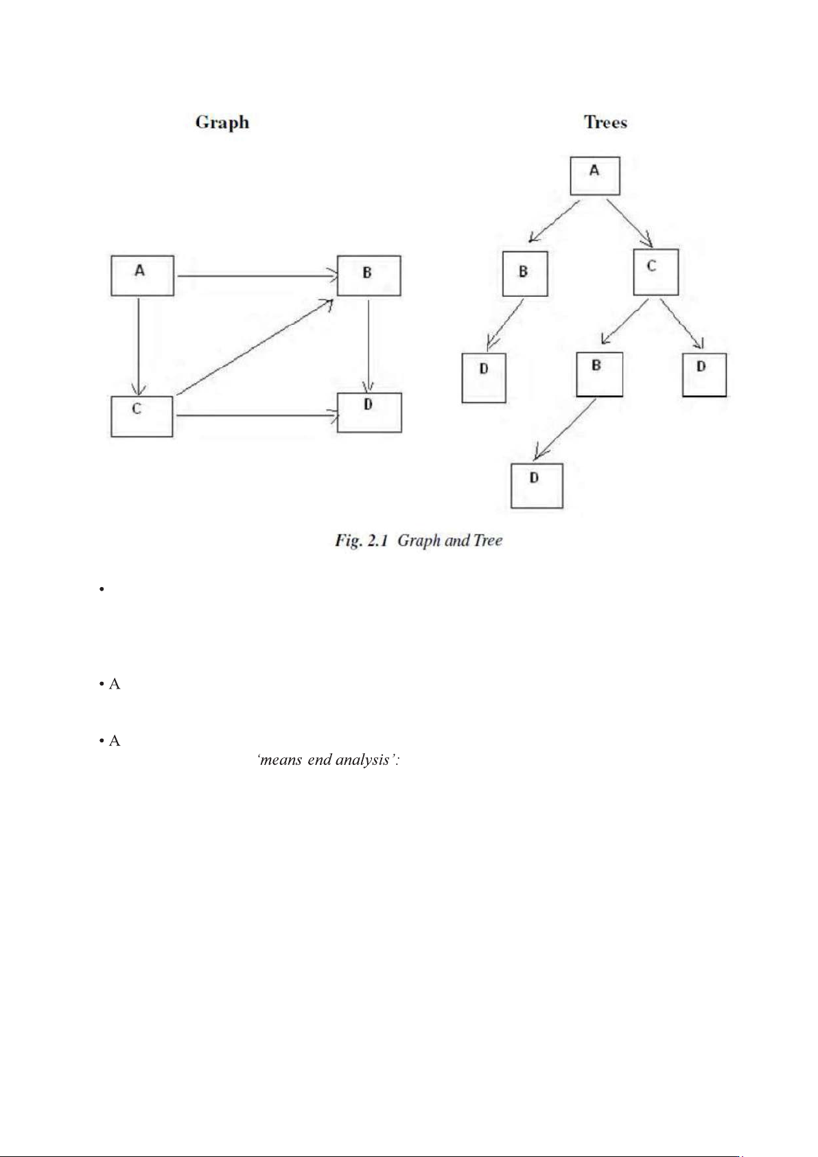
Problem space
23AM2405
A problem space is represented by a directed graph, where nodes represent the search state and paths represent the operators applied to change the state.
To simplify search algorithms, it is often convenient to logically and programmatically represent a problem space as a tree.
A tree usually decreases the complexity of a search at a cost. Here, the cost is due to duplicating some nodes on the tree that were linked numerous times in the graph, e.g. node B and node D.
A tree is a graph in which any two vertices are connected by exactly one path. Alternatively, any connected graph with no cycles is a tree.

Slide 113
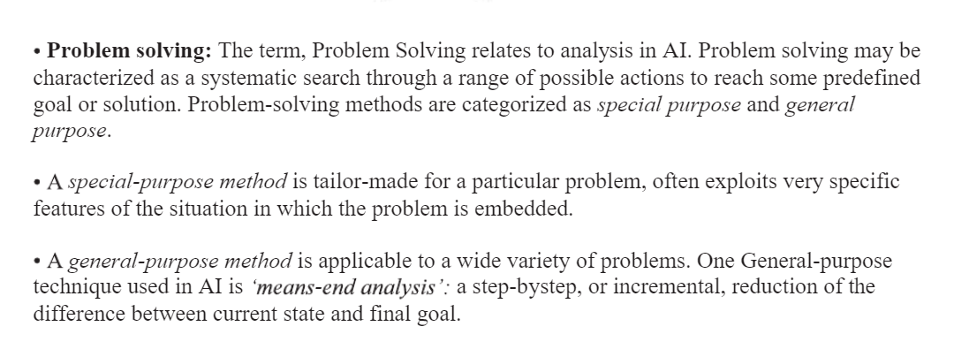
23AM2405

Slide 114
DEFINING PROBLEM AS A STATE SPACE SEARCH
23AM2405
To solve the problem of playing a game, we require the rules of the game and targets for winning as well as representing positions in the game.
The opening position can be defined as the initial state and a winning position as a goal state.
Moves from initial state to other states leading to the goal state follow legally.
The rules are far too abundant in most games, especially in chess, where they exceed the number of particles in the universe.
The number of rules that are used must be minimized and the set can be created by expressing each rule in a form as possible.
The representation of games leads to a state space representation and it is common for well-organized games with some structure.
This representation allows for the formal definition of a problem that needs the movement from a set of initial positions to one of a set of target positions. It means that the solution involves using known techniques and a systematic search.

Slide 115
State Space Search
23AM2405
A state space represents a problem in terms of states and operators that change states.
A state space consists of:
A representation of the states the system can be in. For example, in a board game, the board represents the current state of the game.
A set of operators that can change one state into another state. In a board game, the operators are the legal moves from any given state. Often the operators are represented as programs that change a state representation to represent the new state.
An initial state.
A set of final states; some of these may be desirable, others undesirable. This set is often represented implicitly by a program that detects terminal states.

Slide 116
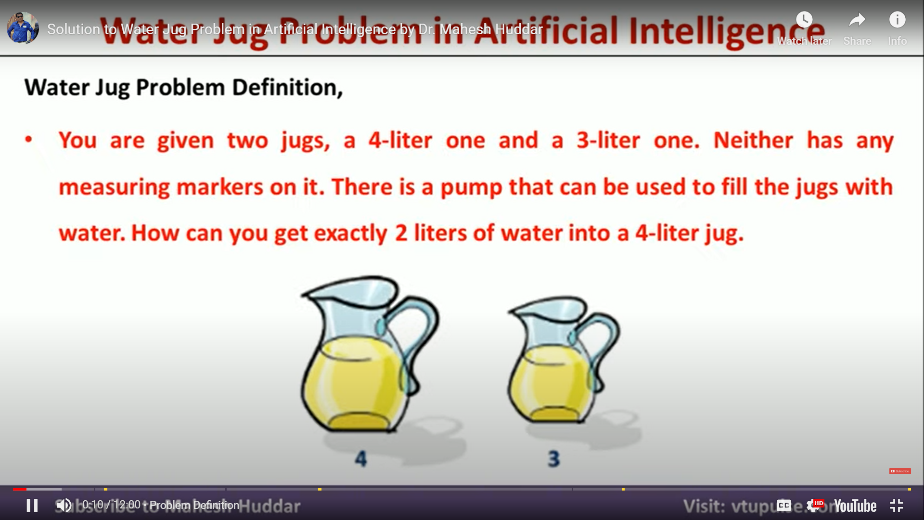
The Water Jug Problem
23AM2405
In this problem, we use two jugs called four and three; four holds a maximum of four gallons of water and three a maximum of three gallons of water. How can we get two gallons of water in the four jug?
The state space is a set of prearranged pairs giving the number of gallons of water in the pair of jugs at any time, i.e., (four, three) where four = 0, 1, 2, 3 or 4 and three = 0, 1, 2 or 3.

Slide 117
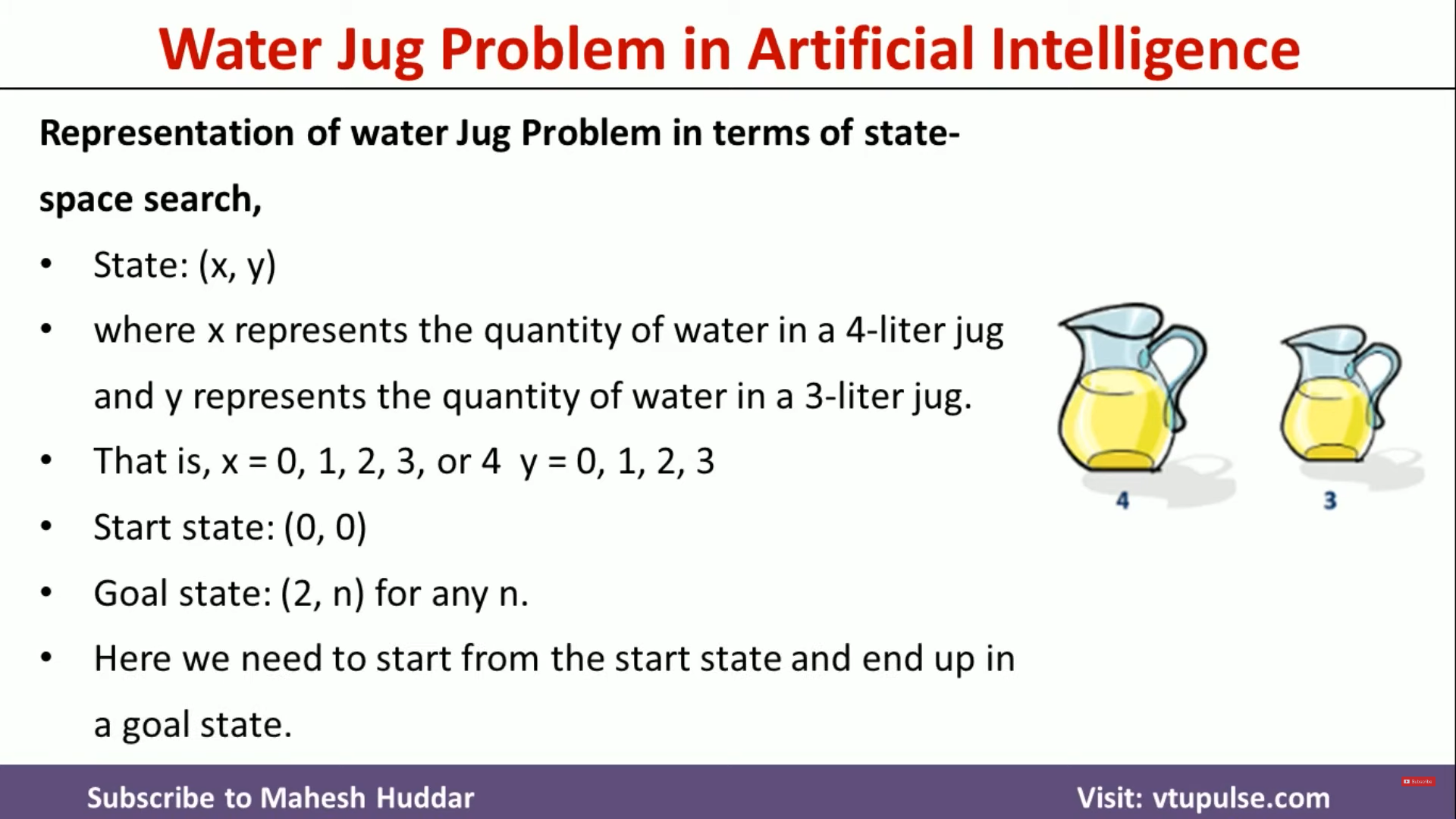
23AM2405
The start state is (0, 0) and the goal state is (2, n) where n may be any but it is limited to three holding from 0 to 3 gallons of water or empty. Three and four shows the name and numerical number shows the amount of water in jugs for solving the water jug problem. The major production rules for solving this problem are shown :

Slide 118
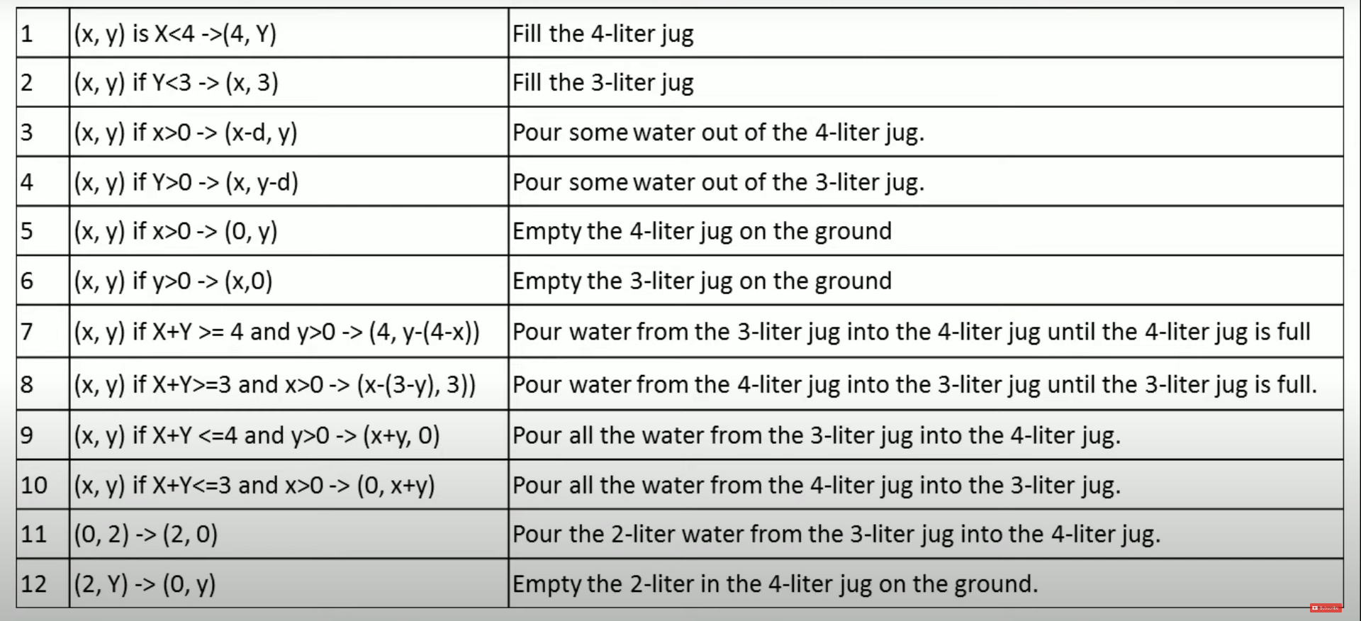
Production Rules
23AM2405

Slide 119
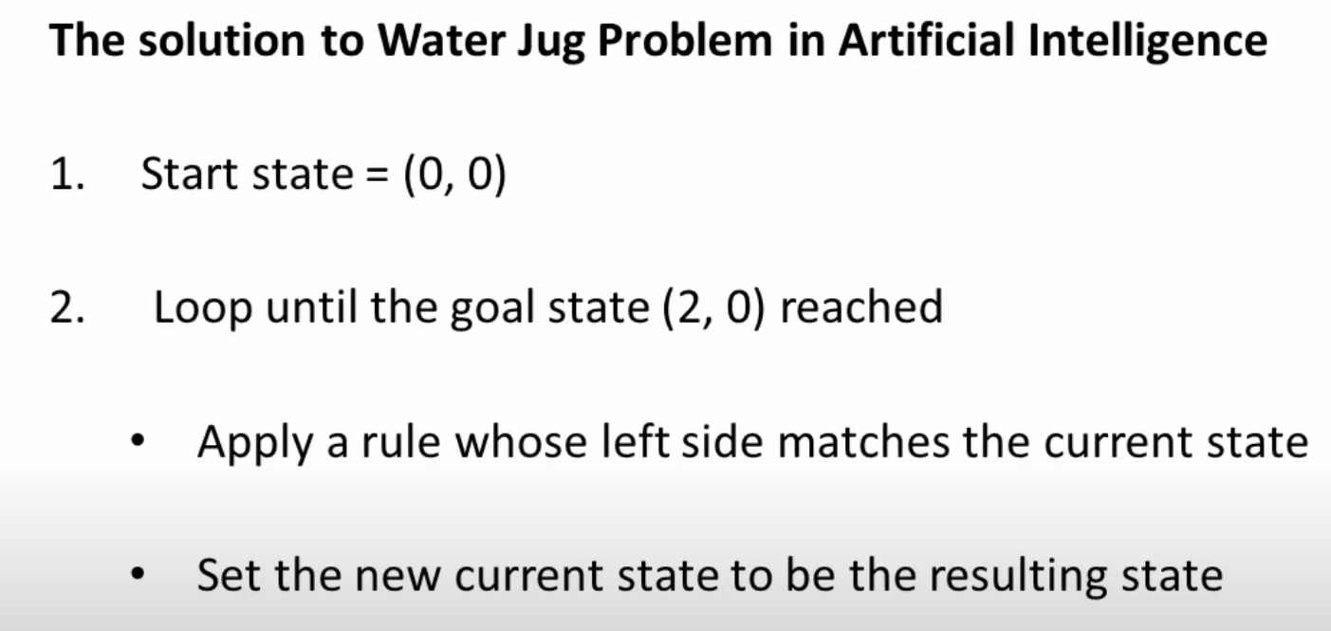
General Approach
23AM2405

Slide 120
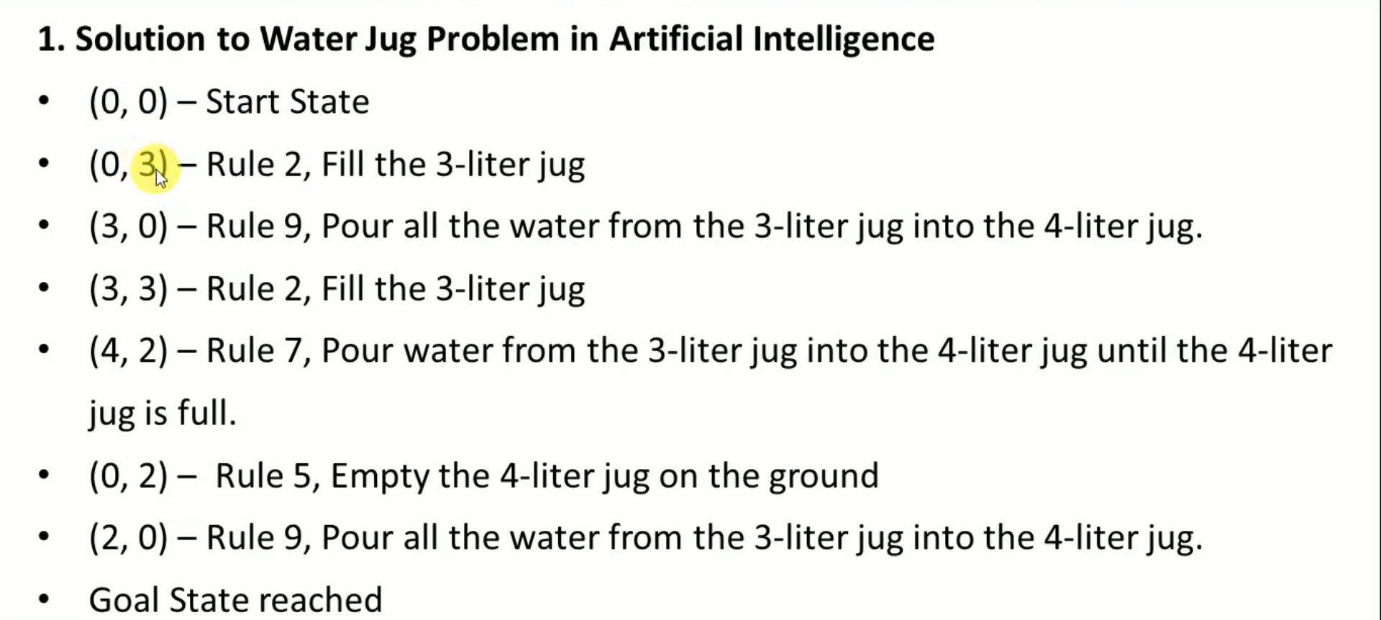
Method 1using Production Rules
23AM2405

Slide 121
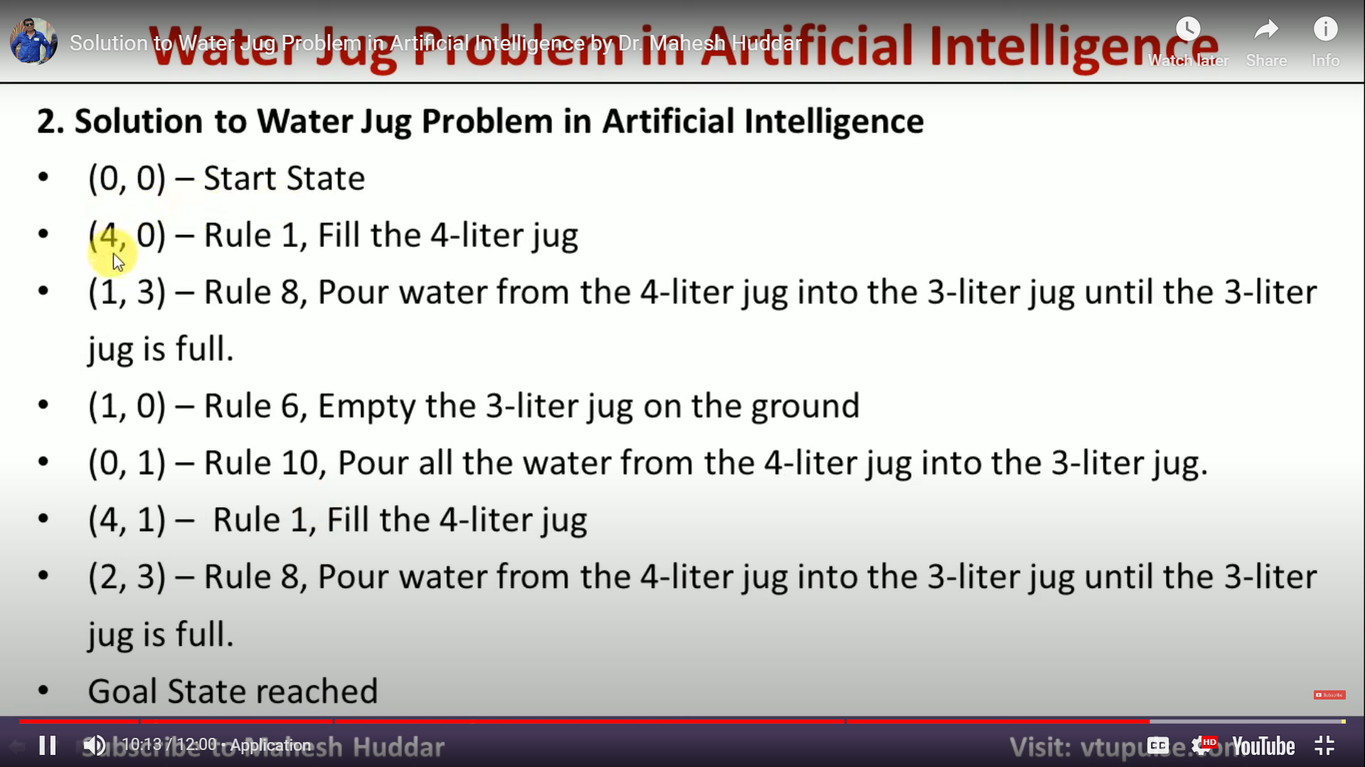
Method 2 using Production Rules
23AM2405
https://www.google.com/search?q=solve+the+water+jug+problem&rlz=1C1UEAD_enIN1034IN1034&oq=The+Water+Jug+Problem+&gs_lcrp=EgZjaHJvbWUqCAgHEAAYFhgeMgYIABBFGDsyBggBEEUYOzIHCAIQABiABDIICAMQABgWGB4yCAgEEAAYFhgeMggIBRAAGBYYHjIICAYQABgWGB4yCAgHEAAYFhgeMggICBAAGBYYHjIICAkQABgWGB7SAQg3OTI3ajBqN6gCALACAA&sourceid=chrome&ie=UTF-8#fpstate=ive&vld=cid:1fc2ef9b,vid:26YyD_K-gpA

Slide 122
Fun program
23AM2405
Try to use the production system for Tic tac toe – (as similar to water jug Program)
Submission of Video / YouTube link 3-5min video with description (English/ Hindi / kannada sub titles)

Slide 123
PROBLEM CHARACTERISTICS
23AM2405
Heuristics cannot be generalized, as they are domain-specific. Production systems provide ideal techniques for representing such heuristics in the form of IF-THEN rules. Most problems requiring simulation of intelligence use heuristic search extensively.
Some heuristics are used to define the control structure that guides the search process, as seen in the example described above.
But heuristics can also be encoded in the rules to represent the domain knowledge. Since most AI problems make use of knowledge and guided search through knowledge, AI can be described as the study of techniques for solving exponentially hard problems in polynomial time by exploiting knowledge about the problem domain.

Slide 124
23AM2405
To use the heuristic search for problem solving, we suggest analysis of the problem for the following considerations:
Decomposability of the problem into a set of independent smaller subproblems.
Possibility of undoing solution steps, if they are found to be unwise.
Predictability of the problem universe.
Possibility of obtaining an obvious solution to a problem without comparison of all other possible solutions .
Type of the solution: whether it is a state or a path to the goal state.
Role of knowledge in problem solving.
Nature of solution process: with or without interacting with the user.

Slide 125
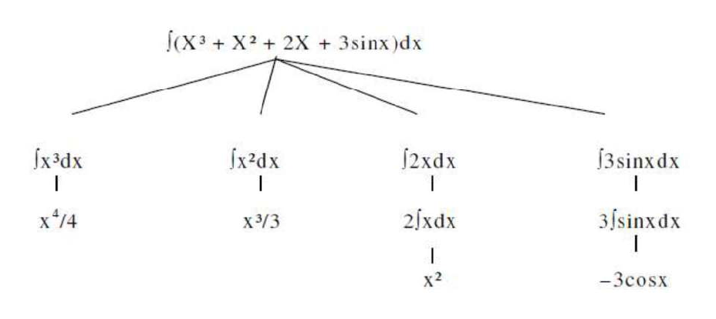
Problem Decomposition
23AM2405
Suppose to solve the expression is: +∫ (X³ + X² + 2X + 3sinx) dx
This problem can be solved by breaking it into smaller problems, each of which we can solve by using a small collection of specific rules. Using this technique of problem decomposition, we can solve very large problems very easily. This can be considered as an intelligent behaviour.

Slide 126
Other examples to be solved – Assignment / craft work / YouTube explanation
23AM2405
8 puzzle problem
Playing a chess using AI

Slide 127
23AM2405
Consider the problem of answering questions based on a database of simple facts such as the following:
1. Siva was a man.
2. Siva was a worker in a company.
3. Siva was born in 1905.
4. All men are mortal.
5. All workers in a factory died when there was an accident in 1952.
6. No mortal lives longer than 100 years.
Facts:
Q1: Suppose a question is – “ is Siva alive”?

Slide 128
“ is Siva alive”?
23AM2405
Method I:
1. Siva was a man.
2. Siva was born in 1905.
3. All men are mortal.
4. Now
5. No mortal lives longer than 100 years.
Method II:
1. Siva is a worker in the company.
2. All workers in the company died in 1952.
Answer: So Siva is not alive. It is the answer from the above methods.

Slide 129
CHARACTERISTICS OF PRODUCTION SYSTEMS
23AM2405
Production systems provide us with good ways of describing the operations that can be performed in a search for a solution to a problem.
At this time, two questions may arise:
1. Can production systems be described by a set of characteristics? And how can they be easily implemented?
2. What relationships are there between the problem types and the types of production systems well suited for solving the problems?
To answer these questions, first consider the following definitions of classes of production systems:
1. A monotonic production system is a production system in which the application of a rule never prevents the later application of another rule that could also have been applied at the time the first rule was selected.
2. A non-monotonic production system is one in which this is not true.
3. A partially communicative production system is a production system with the property that if the application of a particular sequence of rules transforms state P into state Q, then any combination of those rules that is allowable also transforms state P into state Q.
4. A commutative production system is a production system that is both monotonic and partially commutative.

Slide 130
Reference
23AM2405
Text Book:
1. Artificial Intelligence, George F Luger, Sixth Edition, Pearson Education Publications, 2014.
Artificial Intelligence, Elaine Rich and Knight, McGraw-Hill Publications, 2010.
Online Source
1. https://www.geeksforgeeks.org/what-is-reinforcement-learning/
2. https://www.geeksforgeeks.org/agents-artificial-intelligence/#:~:text=In%20artificial%20intelligence%2C%20an%20agent,goal%20or%20set%20of%20goals.
3.https://www.google.com/search?q=solve+the+water+jug+problem&rlz=1C1UEAD_enIN1034IN1034&oq=The+Water+Jug+Problem+&gs_lcrp=EgZjaHJvbWUqCAgHEAAYFhgeMgYIABBFGDsyBggBEEUYOzIHCAIQABiABDIICAMQABgWGB4yCAgEEAAYFhgeMggIBRAAGBYYHjIICAYQABgWGB4yCAgHEAAYFhgeMggICBAAGBYYHjIICAkQABgWGB7SAQg3OTI3ajBqN6gCALACAA&sourceid=chrome&ie=UTF-8#fpstate=ive&vld=cid:1fc2ef9b,vid:26YyD_K-gpA
4. https://www.studocu.com/in/document/vellore-institute-of-technology/refrigeration-and-air-conditioning/aritificial-intelligence/10820657

Slide 131


